Slide 1
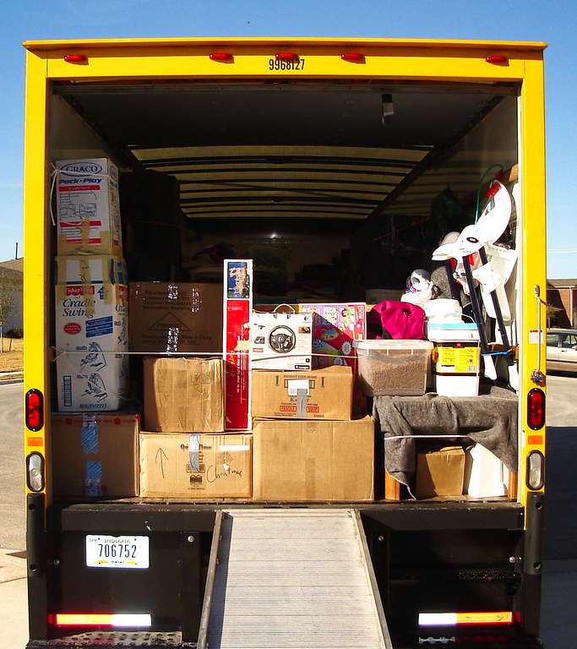
Load.in
Using AI and Computer Vision
to give your move a game plan.
Team Yellow
Design Presentation
Old Dominion University
12/3/2020
Notes:
1

Slide 2
Contents
Feasibility:
Team Biography 3
The Problem 4
Current Process Flow 8
Customers, Benefits 10
The Solution 15
New Process Flow 17
Will & Will not do 21
Design:
MFCD 24
Feedback Loop 25
Work Breakdown 26
User Interface 27
External Interfaces 35
Algorithms 36
Database 47
Sprint Plan 54
Hardware 56
Risk and Mitigation 59
Conclusion 62
Misc.:
References 64
Glossary 65
Specifications 66
User Stories 69
12/3/2020
CS 410 – Team Yellow – Load.In – Design
2
Notes:
2

Slide 3







Team Yellow
Jason Moran
Backend Developer
Lance Perdue
Database Developer
Greg Kukanich
Front End Developer
Byron Aquilino
Full Stack Developer
Daniel Reyna
Backend Developer
Chris Miller
Front End Developer
Paul Rodriguez
Front End Developer
12/3/2020
CS 410 – Team Yellow – Load.In – Design
3
Notes:
3

Slide 4

“Do It Yourself” movers lack the expert knowledge required to handle the logistics of their move.
This Photo by theritemove.com is licensed under CC BY
12/3/2020
CS 410 – Team Yellow – Load.In – Design
4
Notes:
4

Slide 5
Do it Yourself Moving
Professional movers reduces the time but increases cost
DIY reduces the cost but decreases efficiency
This is where Load.in Comes in
12/3/2020
CS 410 – Team Yellow – Load.In – Design
5
Notes:
5

Slide 6
Professional Movers are Costly
12/3/2020
CS 410 – Team Yellow – Load.In – Design
6
Notes:
6

Slide 7
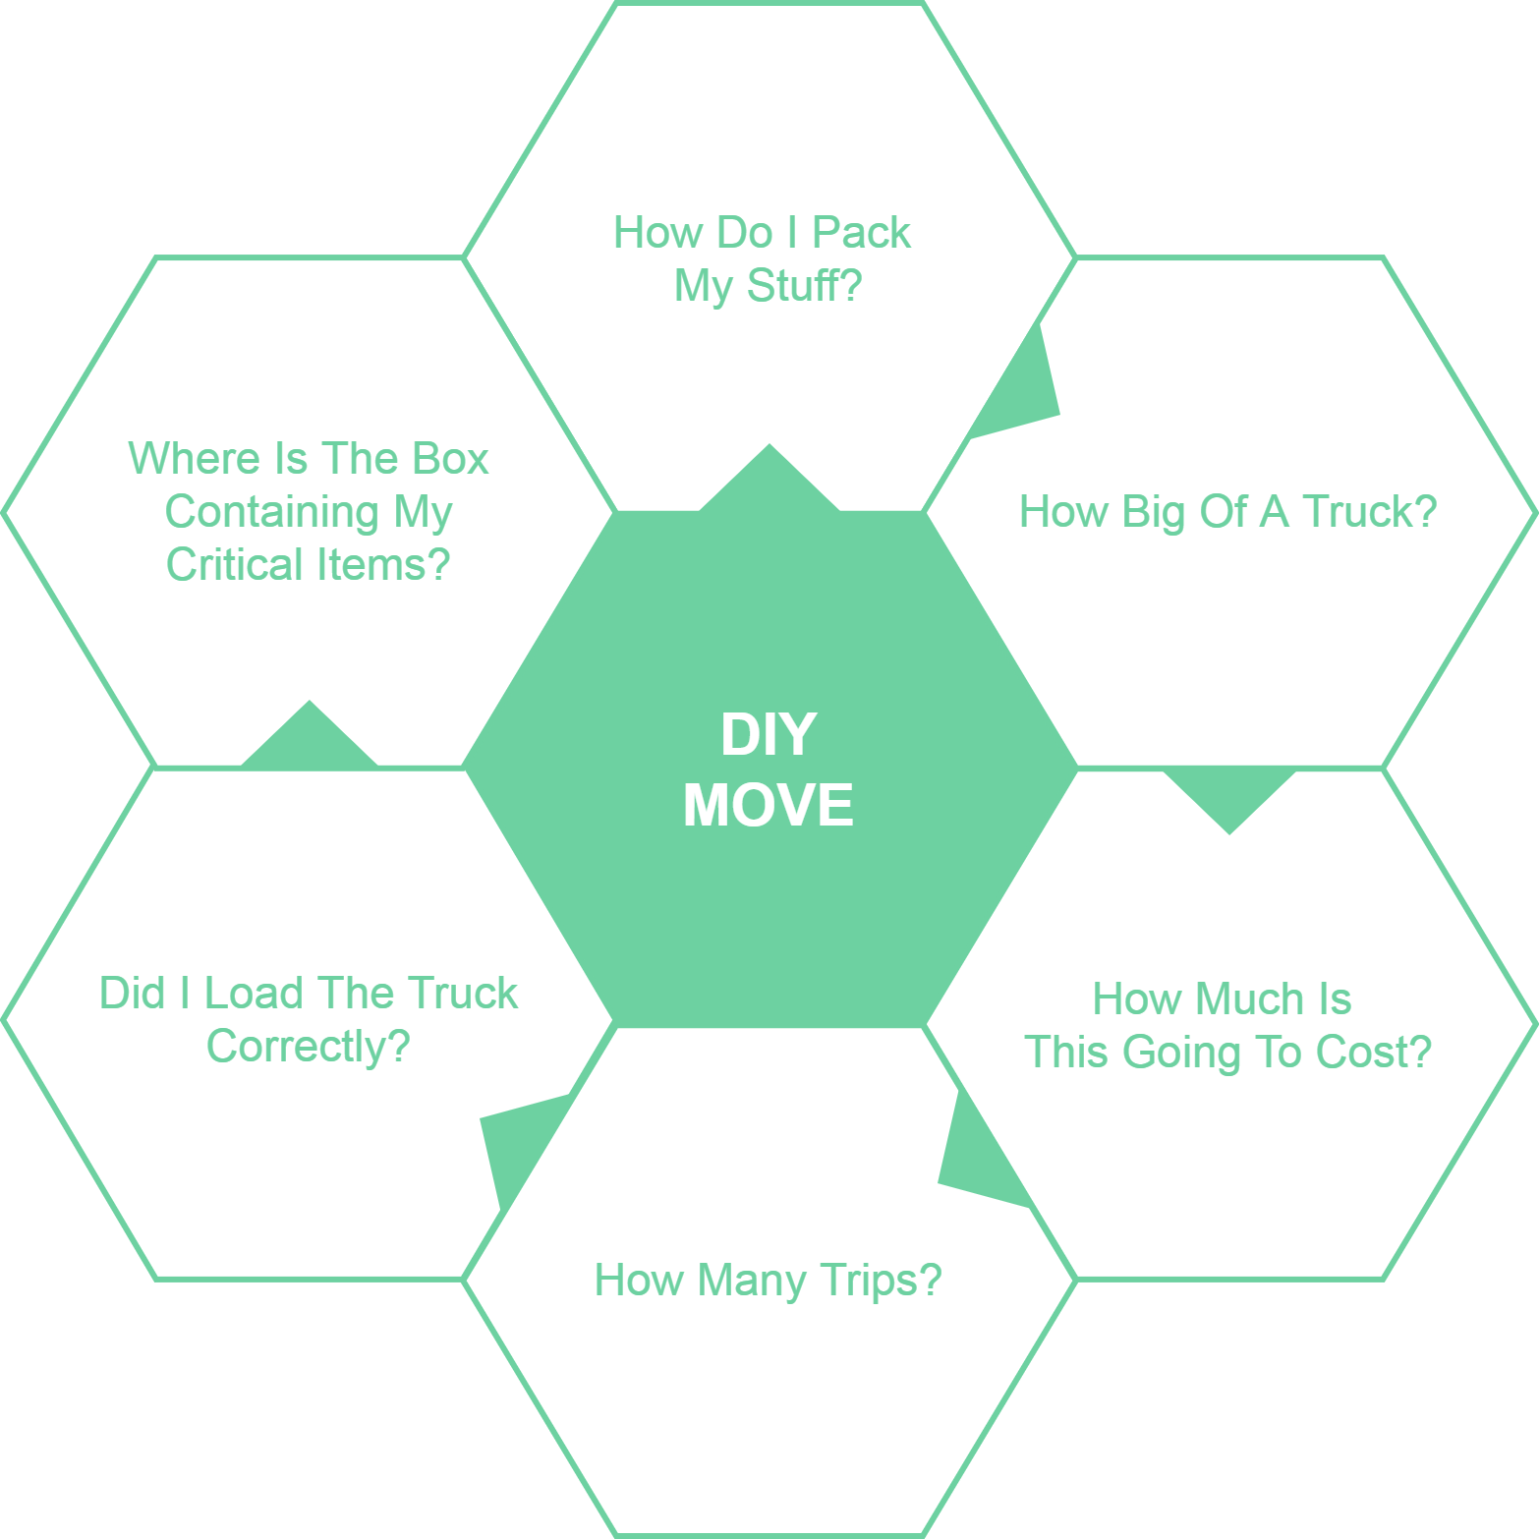
12/3/2020
CS 410 – Team Yellow – Load.In – Design
7
Notes:
7

Slide 8
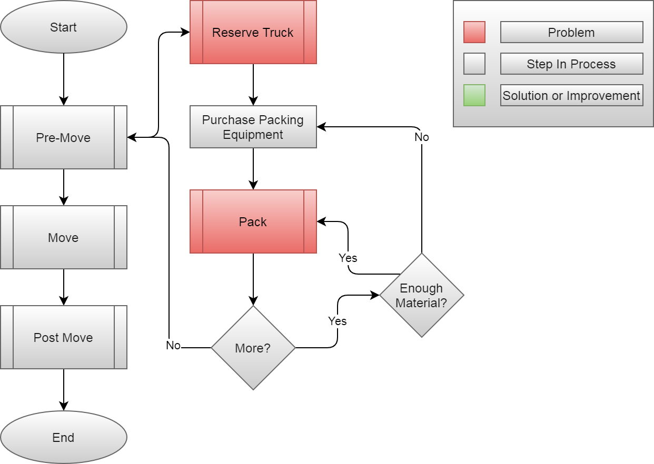
Current Process
12/3/2020
CS 410 – Team Yellow – Load.In – Design
8
Notes:
8

Slide 9
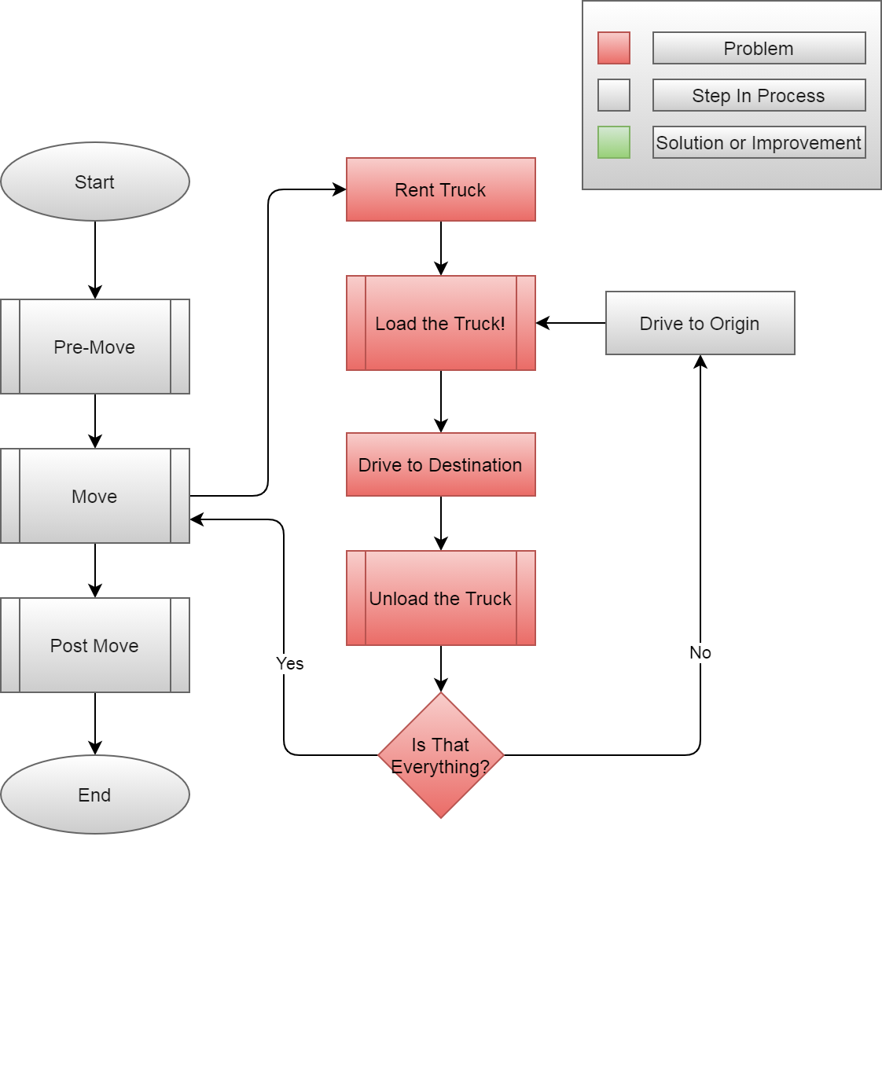
12/3/2020
CS 410 – Team Yellow – Load.In – Design
9
Notes:
9

Slide 10

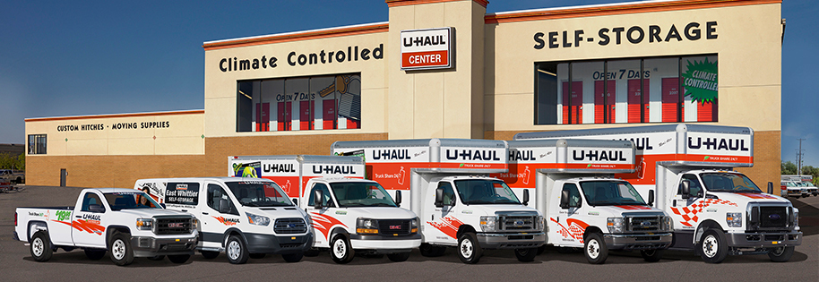
Customers and End Users
Do it yourself Movers
Looking to save on
Time
Money
Stress
Anxiety
Moving Rental Companies
Looking to appeal more to DIY movers
Increase revenue while reducing risk
CS 410 – Team Yellow – Load.In – Design
10

Slide 11
Benefits to Customer
Do It Yourself Mover
Being shown how to
Pack boxes for increased organization
Properly load their truck for increased efficiency
Being provided with expert advice
Database full of tips that a user can search through with keywords
Live-chat support for questions not answered through the tips
Saving of Time and Money
Increased efficiency will lead to less trips and materials used
Peace of Mind
Fragile items being safely transported
Moving Rental Companies
Become more appealing to do it yourself movers
Being able to provide them with a game plan in their move process
Reduce Risk and Increase Revenue
Load.In provides plan and reduces time but still leads to truck rentals
CS 410 – Team Yellow – Load.In – Design
11

Slide 12


User Roles
Mover
Move Expert
Rental Company Representative
Do it yourself mover
Looking to reduce the cost and time needed to move
Expert in the moving industry
Provides tips and advice to DIY movers
Employee of a moving rental company
Can provide customer with rental truck and materials
CS 410 – Team Yellow – Load.In – Design
12

Slide 13



User Roles
Website Visitor
Chat-Bot Manager
Administrator
Do it yourself mover accessing website
Looking for help on their move
User who communicates with customer when FAQ fails
System super user
Has ability to access internal systems for user support
CS 410 – Team Yellow – Load.In – Design
13

Slide 14

User Roles
Tester
Will assume any of the other roles
Will input fake data to test systems for errors
CS 410 – Team Yellow – Load.In – Design
14

Slide 15

Load.In Gives Your Move a Game Plan
Uses artificial intelligence and computer vision
Provides
Expert-level instructions
Tips and tricks on moving day
This Photo by realtor.com is licensed under CC BY
12/3/2020
CS 410 – Team Yellow – Load.In – Design
15
Notes:
15

Slide 16
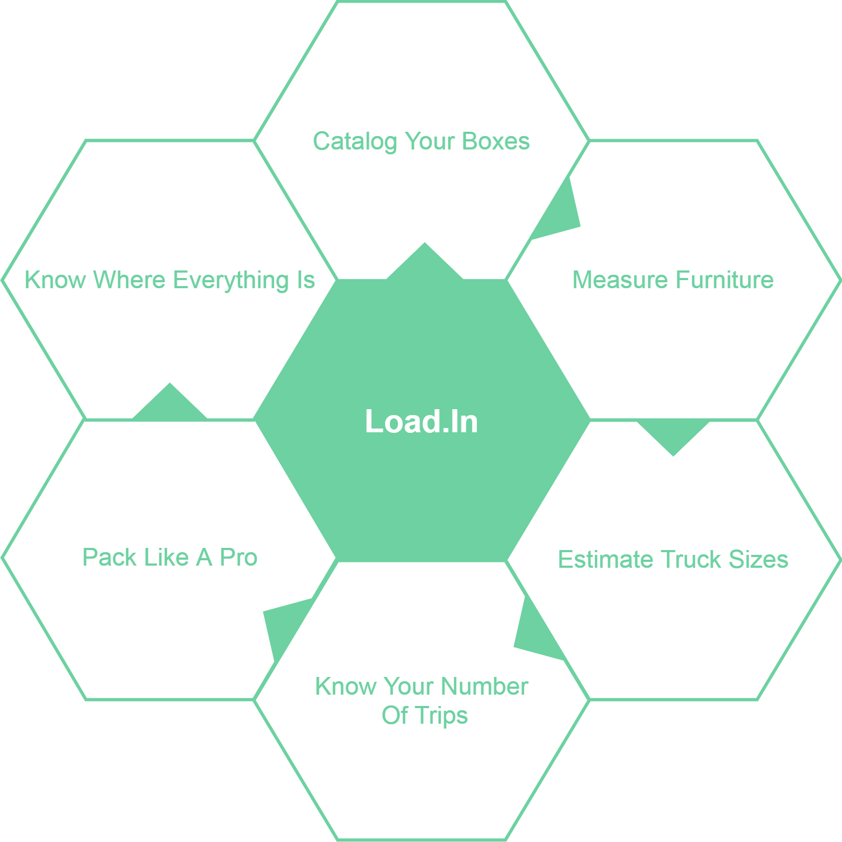
What Can Load.In Do
For You?
12/3/2020
CS 410 – Team Yellow – Load.In – Design
16
Notes:
16

Slide 17
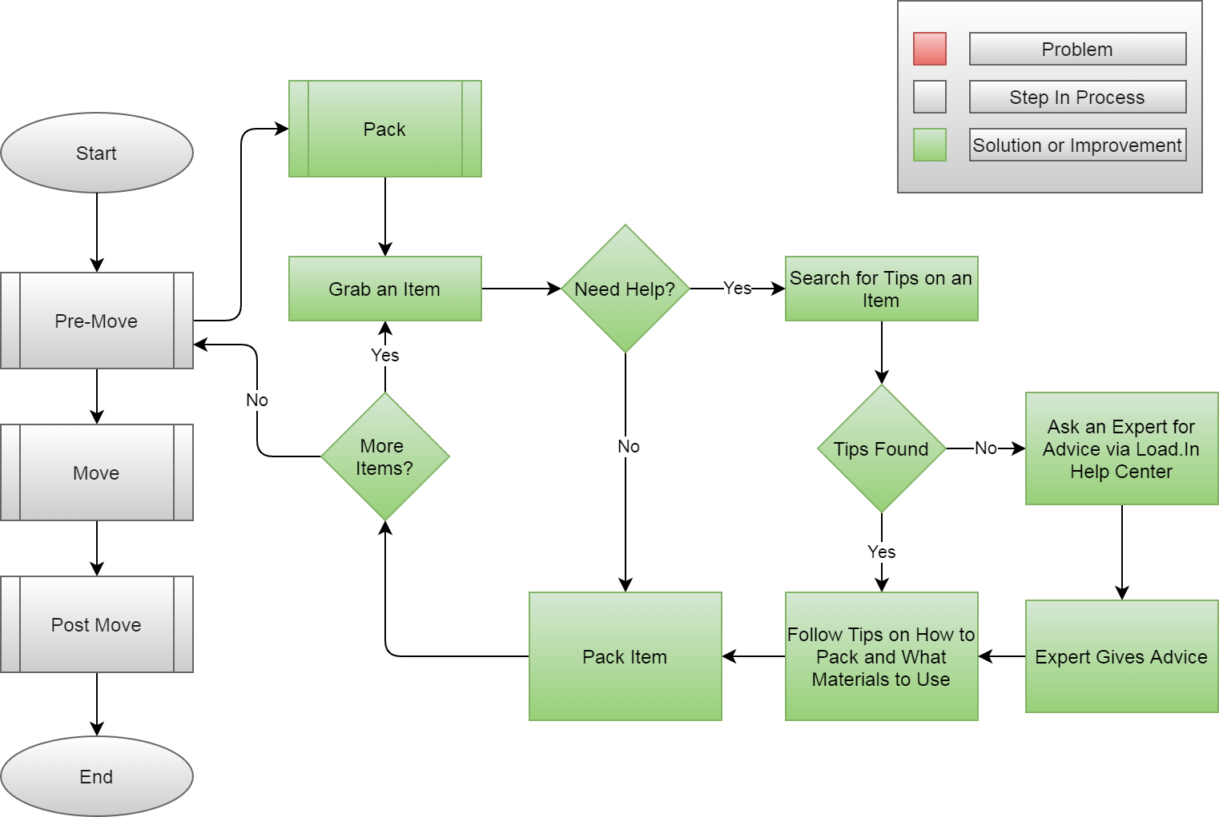
How Will the Solution Help?
12/3/2020
CS 410 – Team Yellow – Load.In – Design
17
Notes:
17

Slide 18
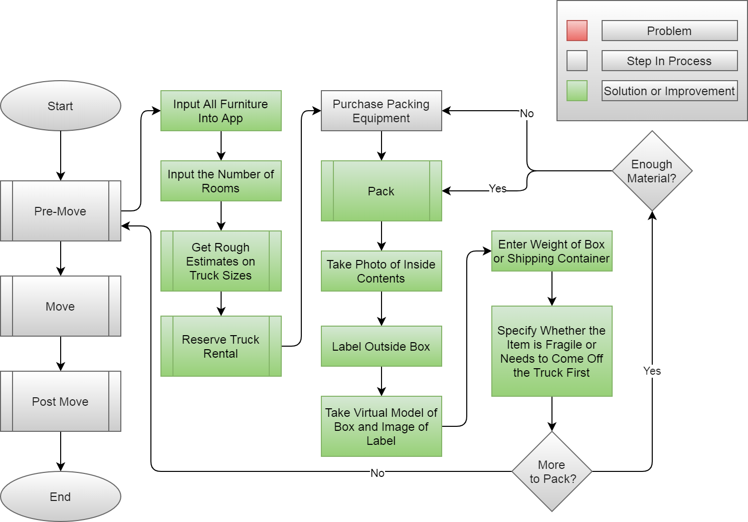
12/3/2020
CS 410 – Team Yellow – Load.In – Design
18
Notes:
18

Slide 19
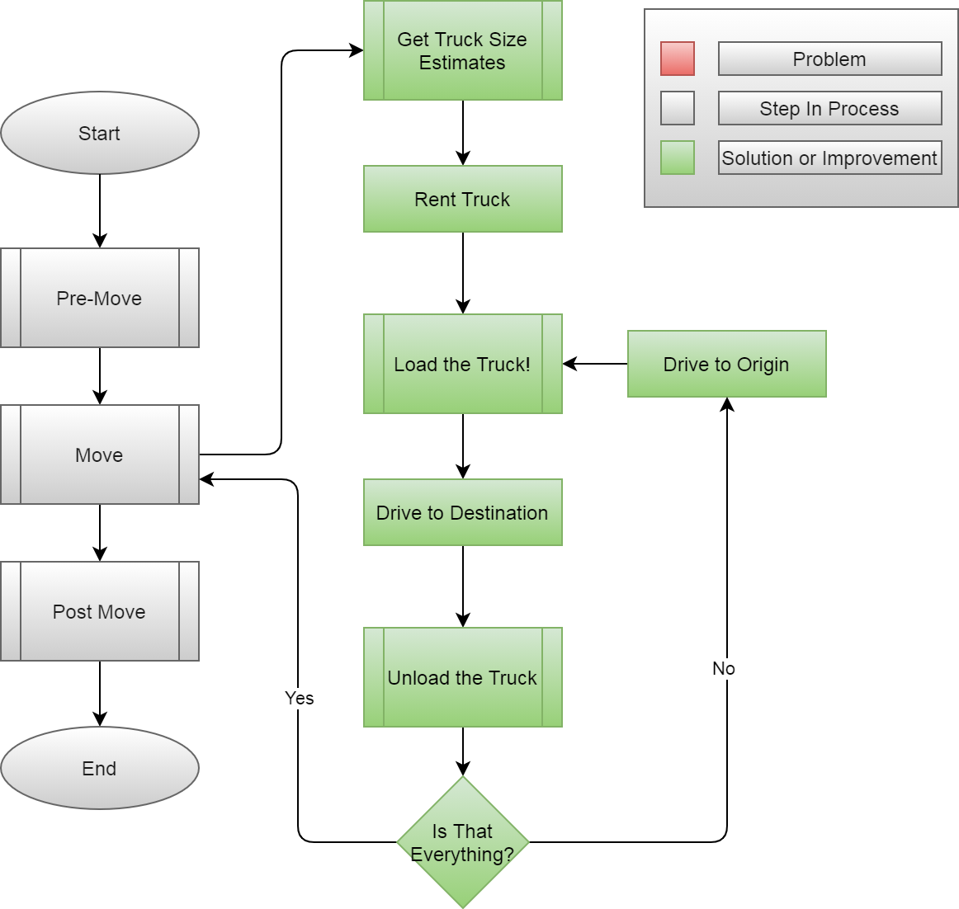
12/3/2020
CS 410 – Team Yellow – Load.In – Design
19
Notes:
19

Slide 20
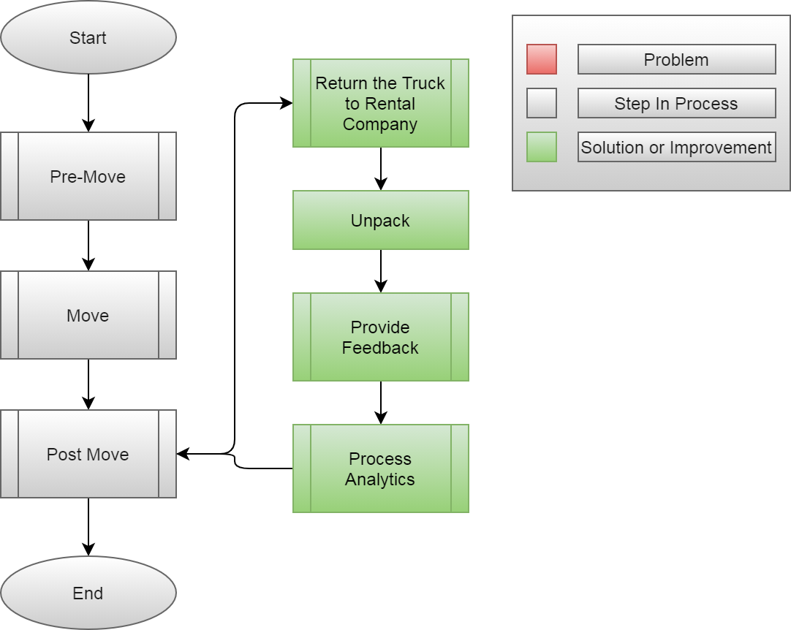
12/3/2020
CS 410 – Team Yellow – Load.In – Design
20
Notes:
20

Slide 21
What Load.In Will Do
Assist in the packing process with Expert Advice
Catalog with photos all boxes, furniture, and other items that are going to be placed in the truck
Generate instructions for properly loading the truck based on weight distribution, item safety, best fit space utilization, and item(s) priority
Use photos taken to Create a 3D model of how everything should be expertly packed in the truck
Will provide location information for different boxes and items within the truck using 3D model and cataloging
Give estimate for appropriate rental truck size and number of trips dependent on truck size
12/3/2020
CS 410 – Team Yellow – Load.In – Design
21
Notes:
21

Slide 22
What Load.In Will Not Do
Sell or share personal info
Keep photos long-term
Read SMS messages
Record audio
Hold on to personal information permanently
12/3/2020
CS 410 – Team Yellow – Load.In – Design
22
Notes:
22

Slide 23


Solution Deliverables
Android App
Distributed via android store
Communication is HTTP REST API with backend
Website App
Published online for browser interaction
Communication is HTTP REST API with backend
CS 410 – Team Yellow – Load.In – Design
23
This Photo by Unknown Author is licensed under CC BY-SA

Slide 24
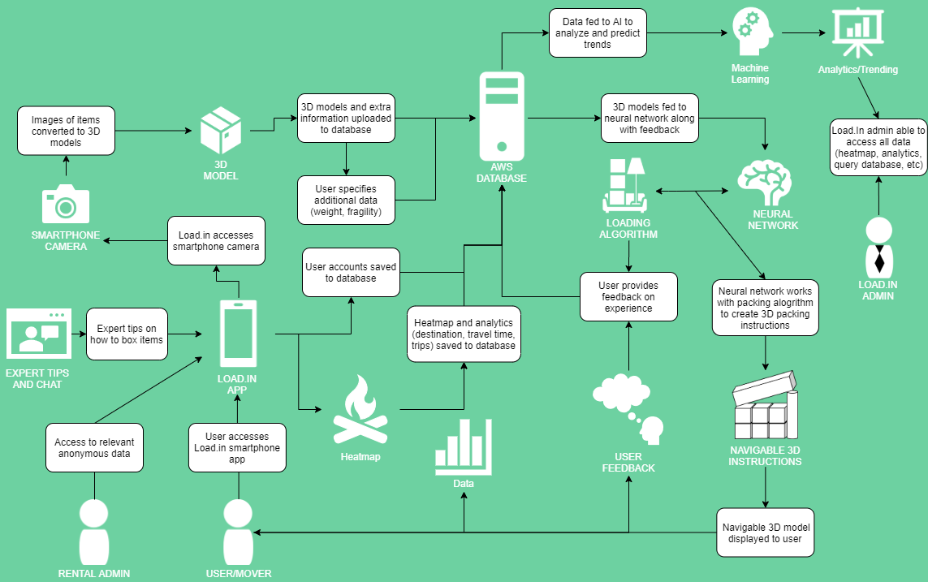
Major Functional Components
12/3/2020
CS 410 – Team Yellow – Load.In – Design
24
Notes:
24

Slide 25











Feedback Loop
4
3
Input
Training data
6
5
2
1
Pro loading strategy
Neural Network
Output
App generates 3D models of objects to move
Incorporate Feedback in to training data generation
Experience
Instructions
User gives feedback
User follows plan
Loading Plan
12/3/2020
CS 410 – Team Yellow – Load.In – Design
25
Notes:
25

Slide 26
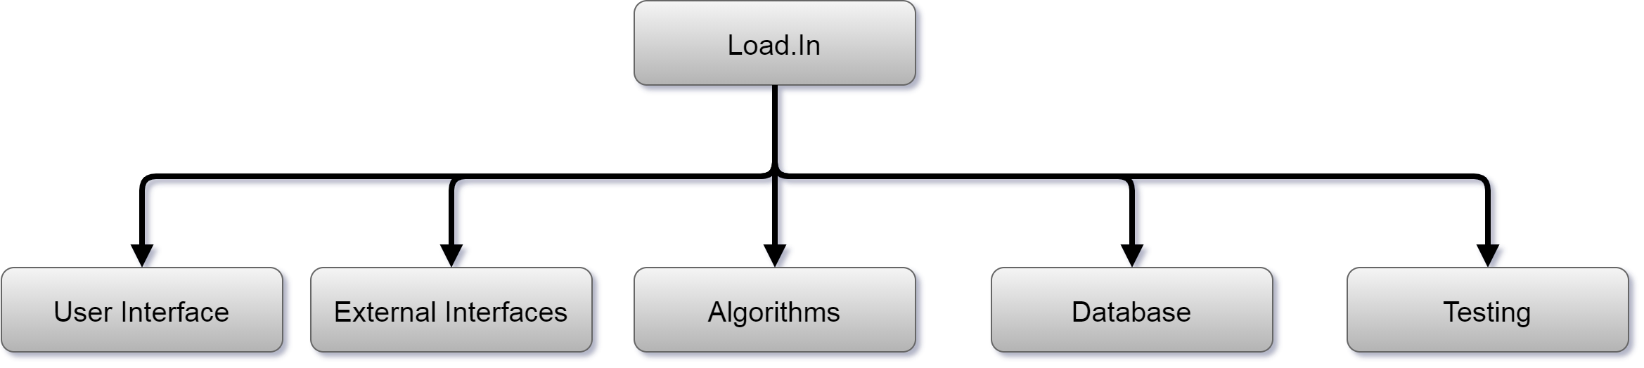
Work Breakdown Structure
12/3/2020
CS 410 – Team Yellow – Load.In – Design
26

Slide 27
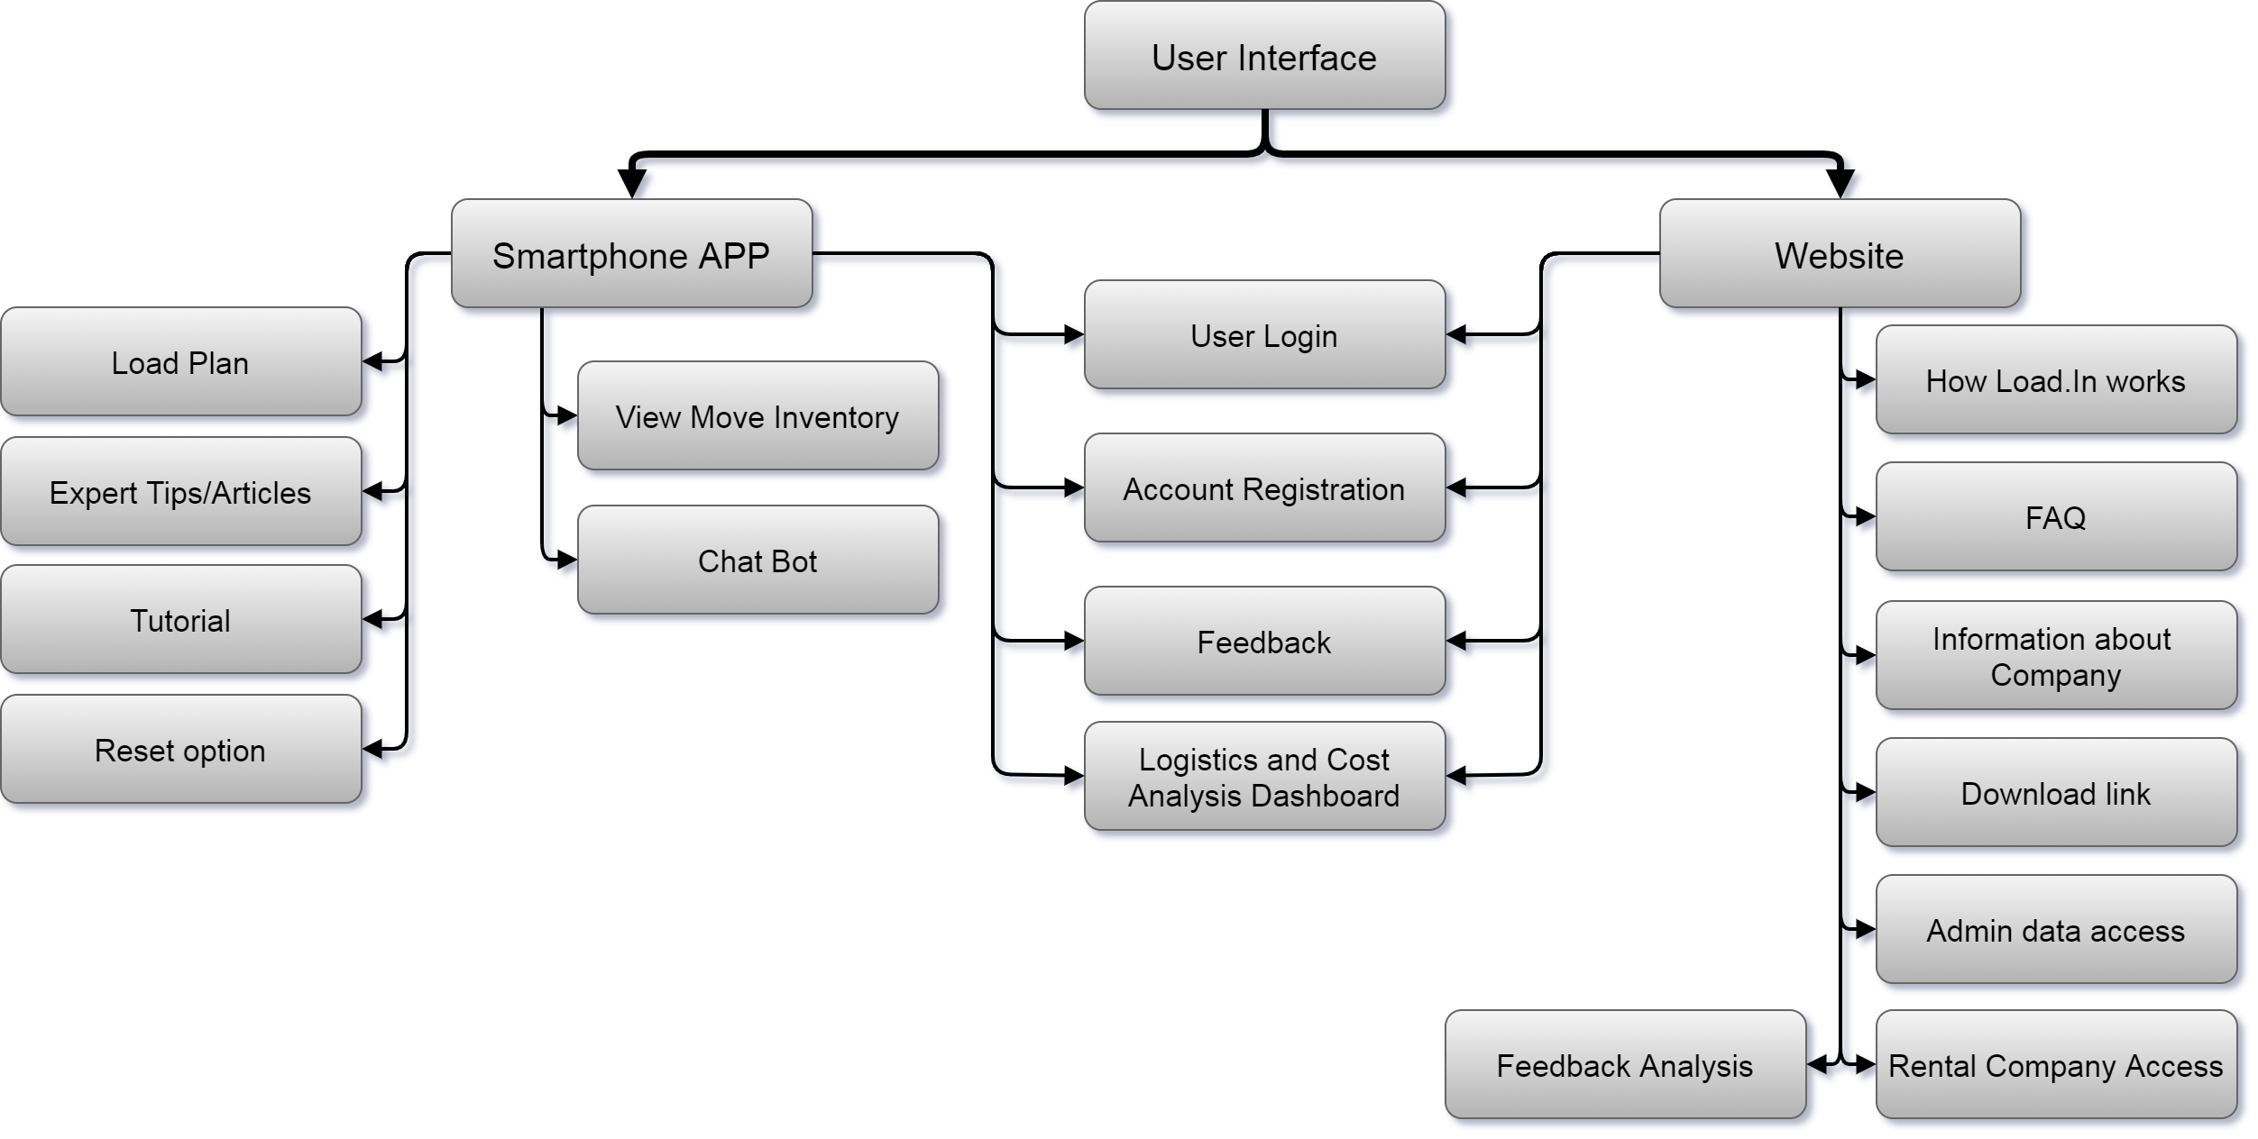
User Interface
12/3/2020
CS 410 – Team Yellow – Load.In – Design
27

Slide 28

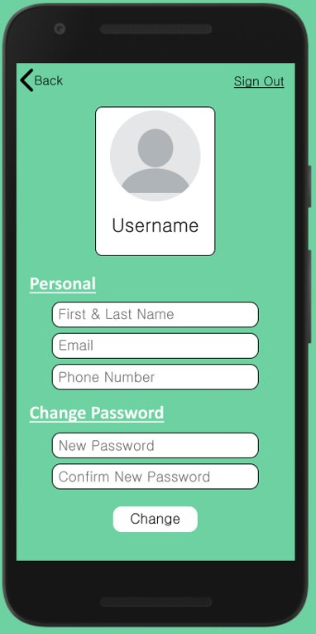
Mockups
CS 410 – Team Yellow – Load.In – Design
28

Slide 29
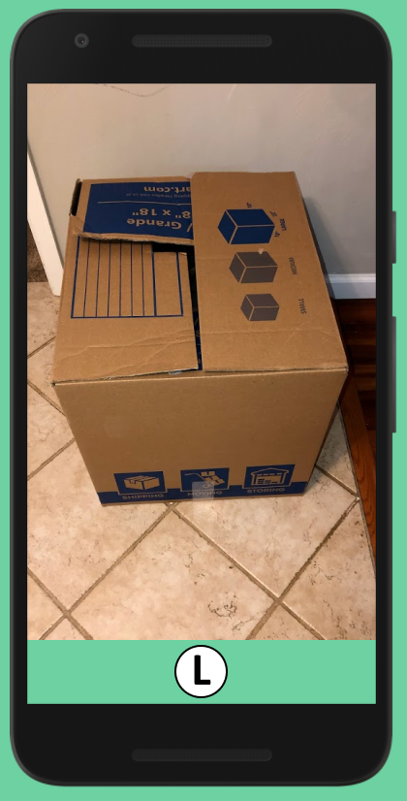
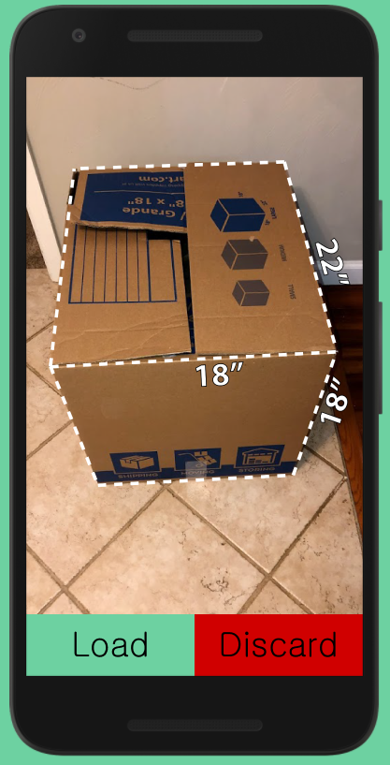
CS 410 – Team Yellow – Load.In – Design
29

Slide 30
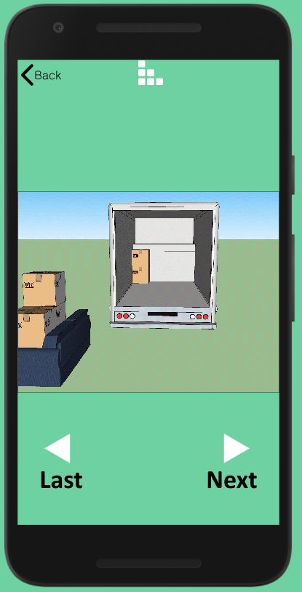
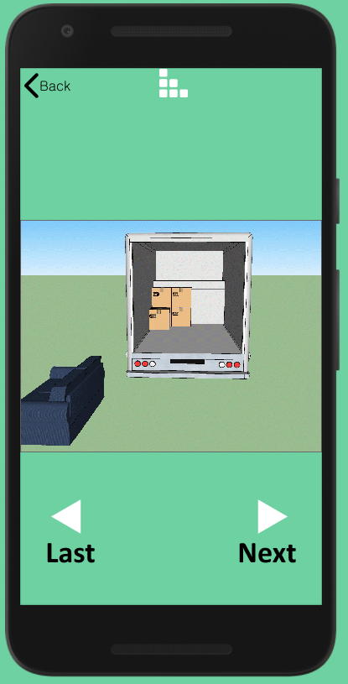
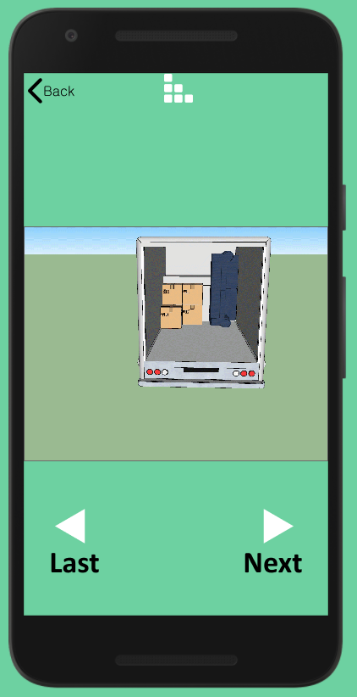
CS 410 – Team Yellow – Load.In – Design
30

Slide 31
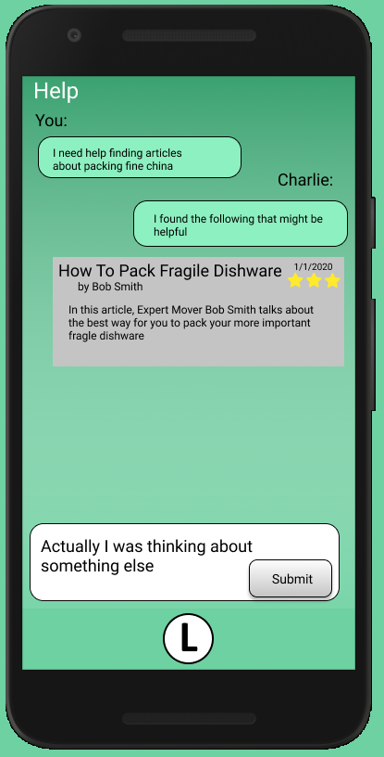
CS 410 – Team Yellow – Load.In – Design
31

Slide 32
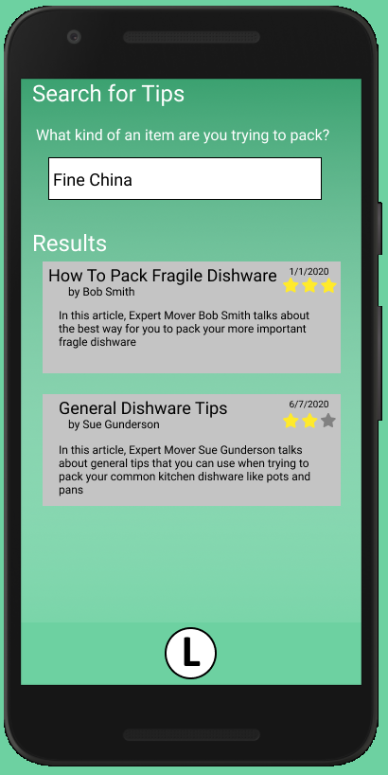
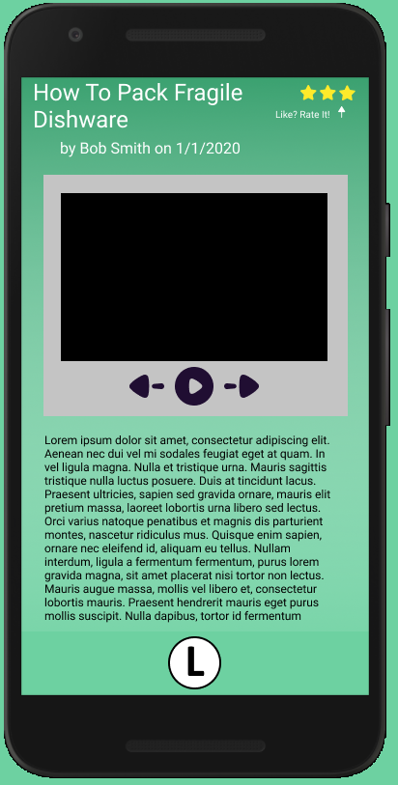
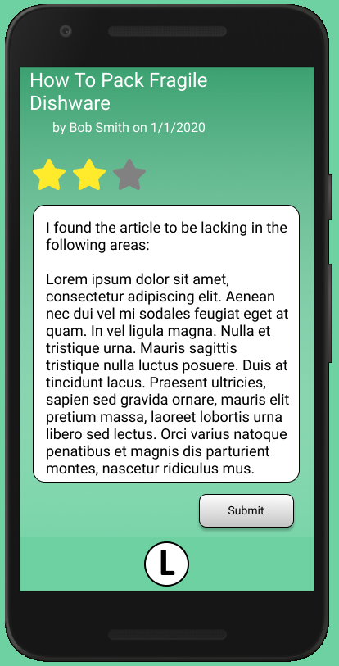
CS 410 – Team Yellow – Load.In – Design
32

Slide 33
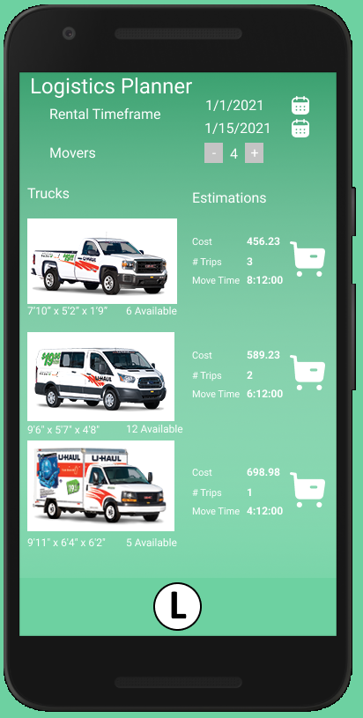
CS 410 – Team Yellow – Load.In – Design
33

Slide 34
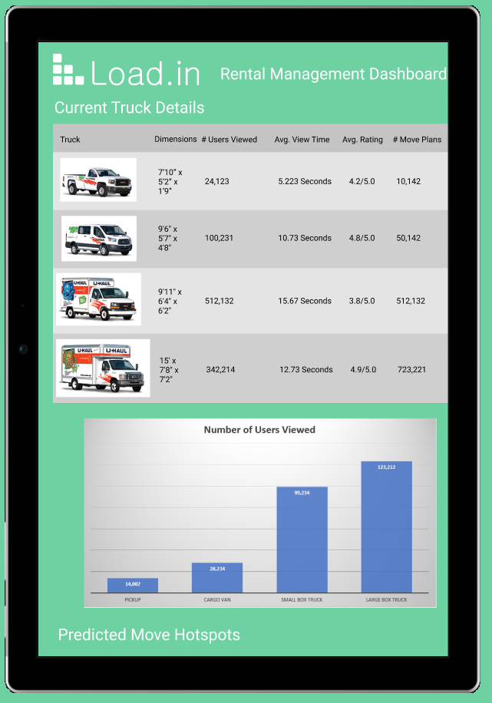
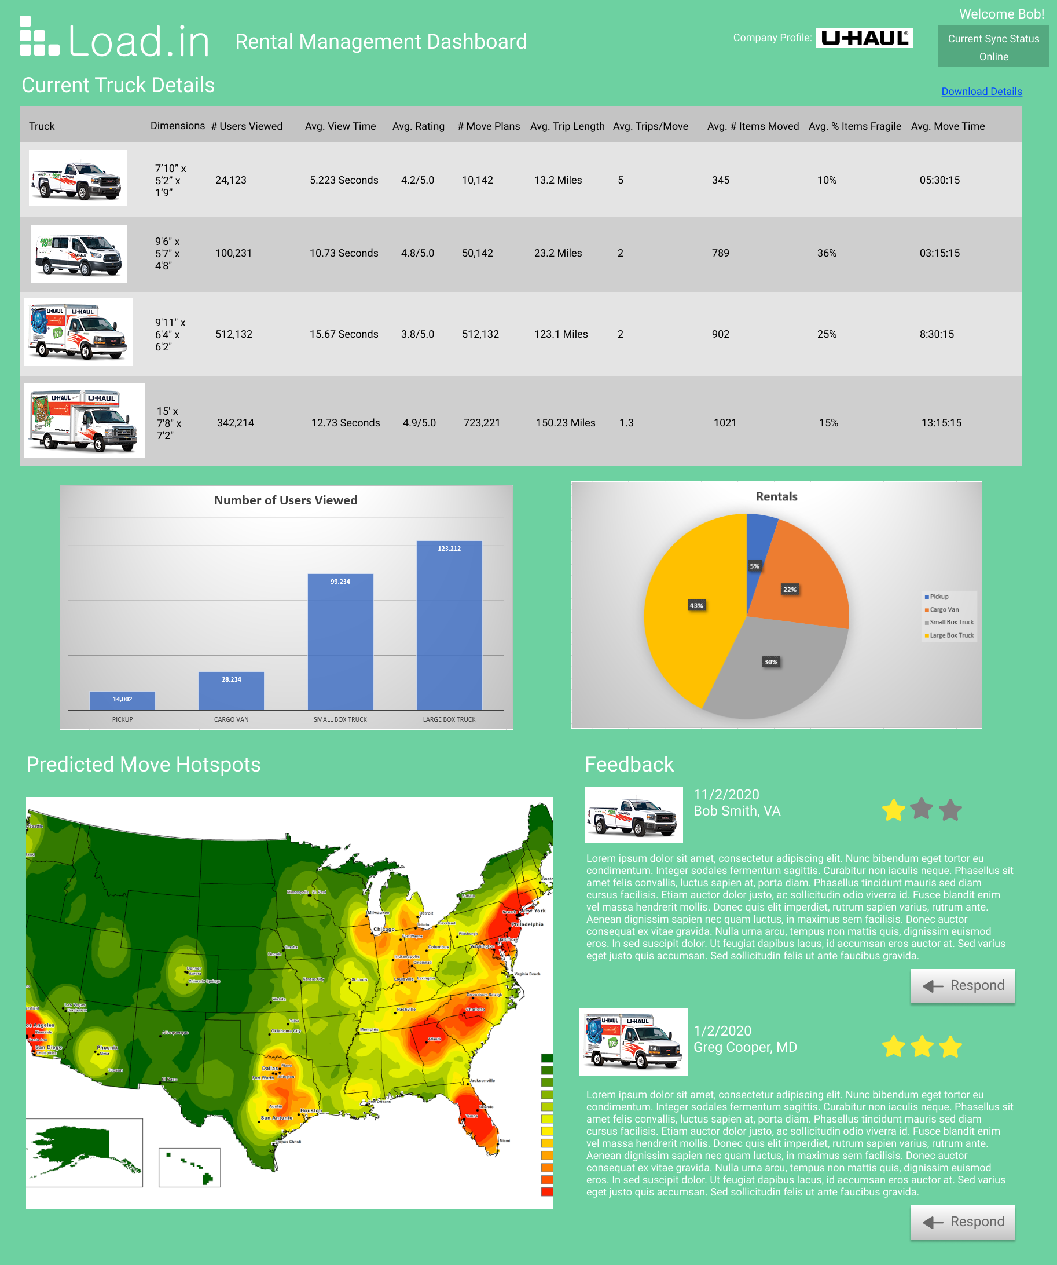
CS 410 – Team Yellow – Load.In – Design
34

Slide 35
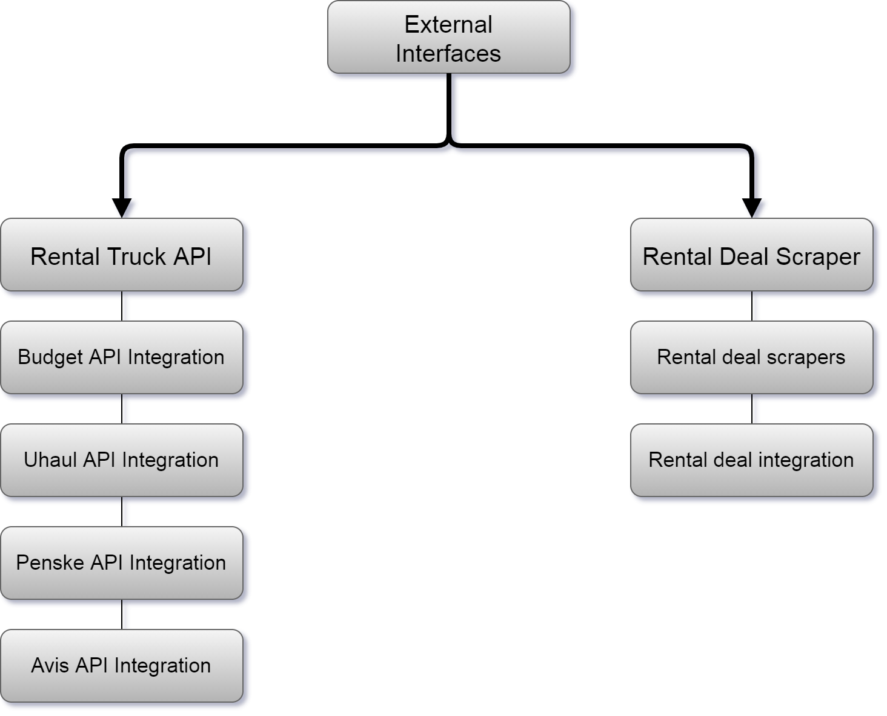
External Interfaces
12/3/2020
CS 410 – Team Yellow – Load.In – Design
35

Slide 36
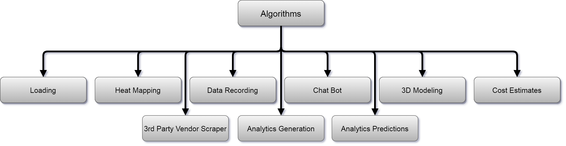
Algorithms
12/3/2020
CS 410 – Team Yellow – Load.In – Design
36

Slide 37
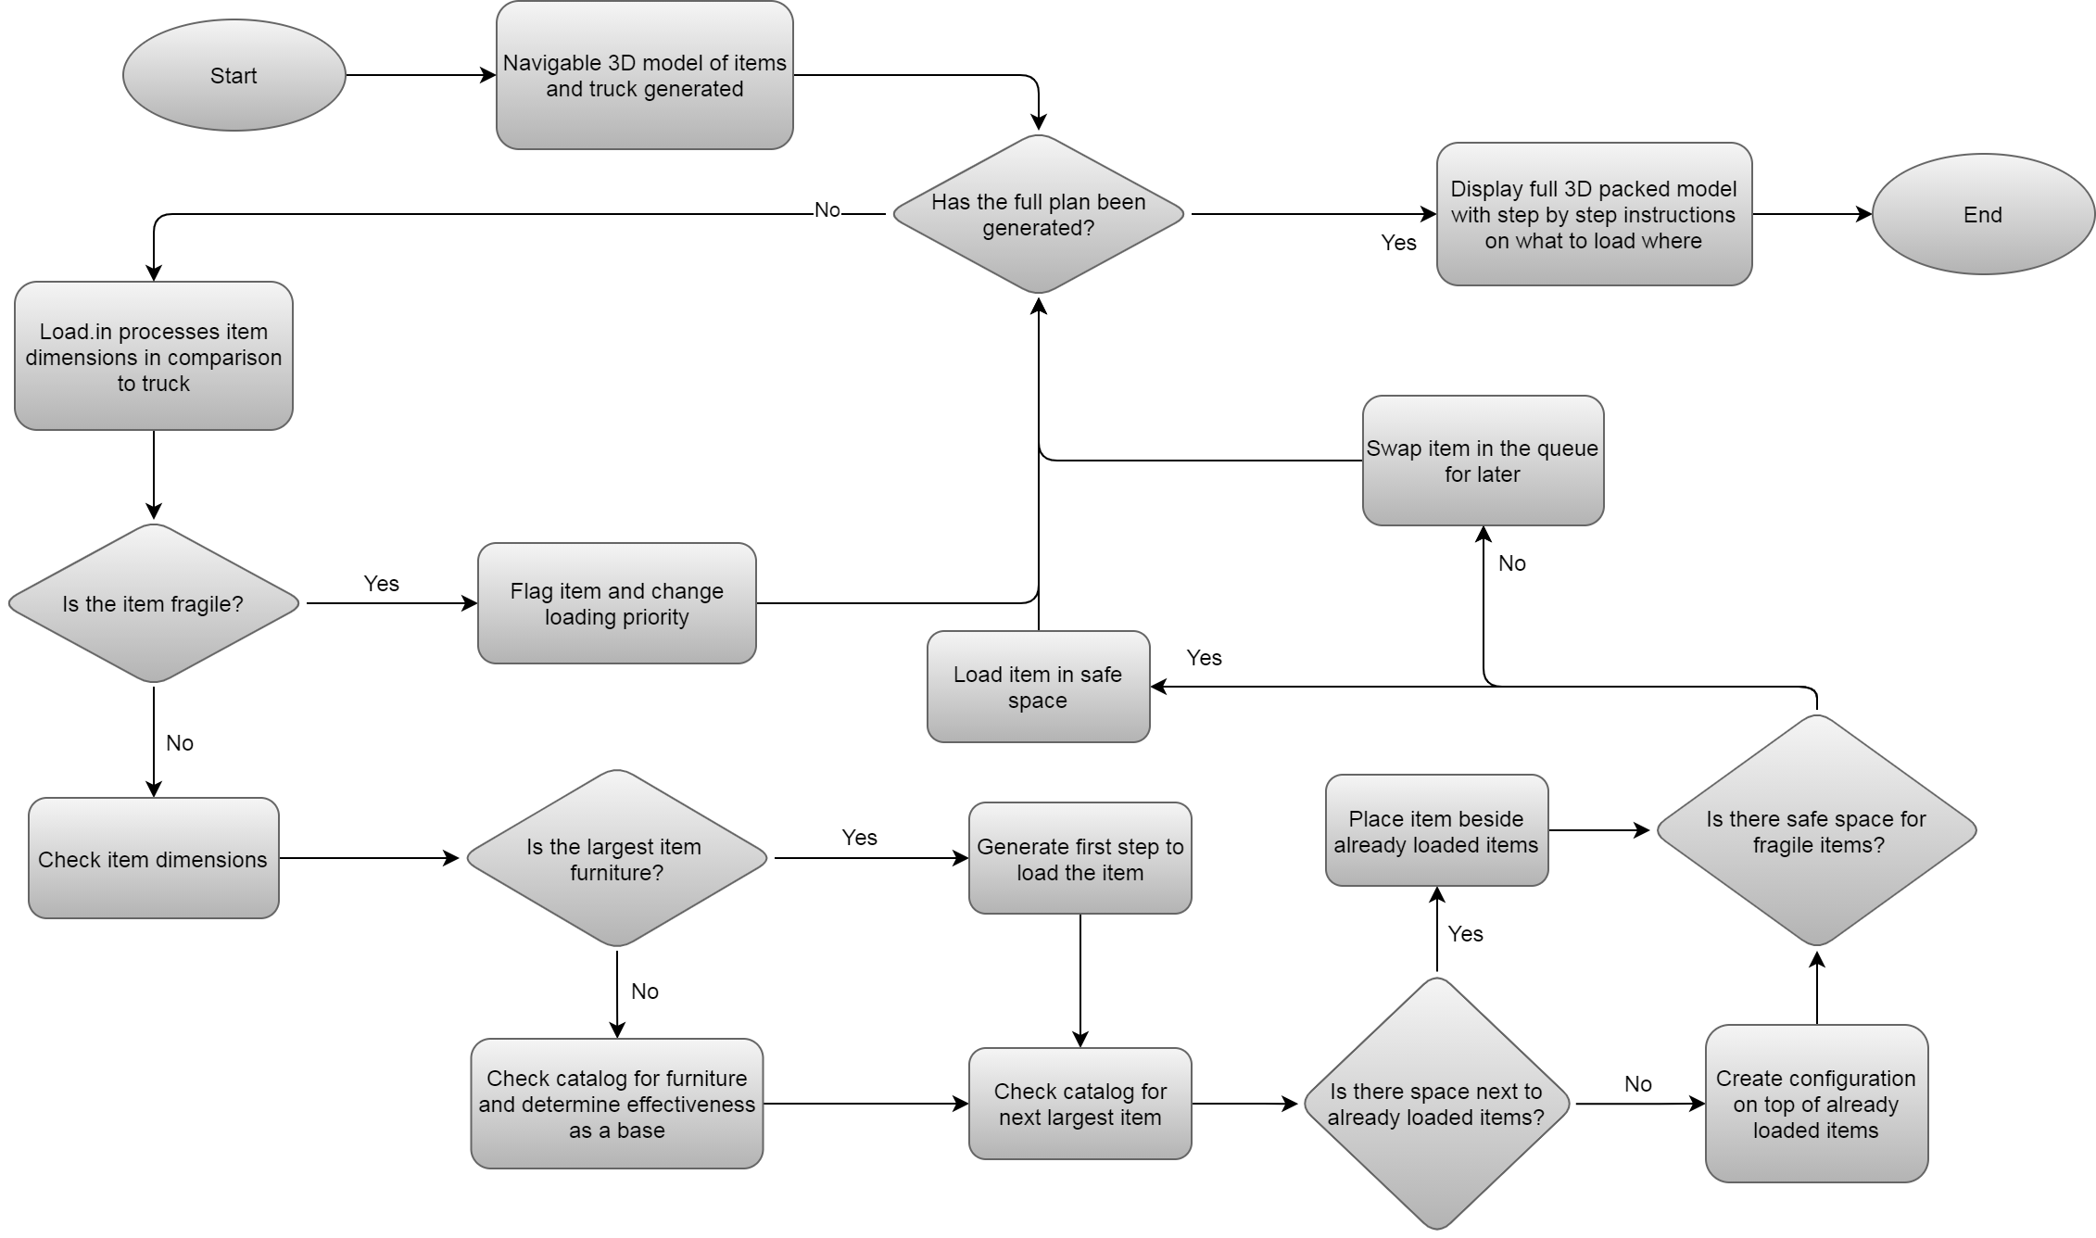
Loading Algorithm
CS 410 – Team Yellow – Load.In – Design
37

Slide 38
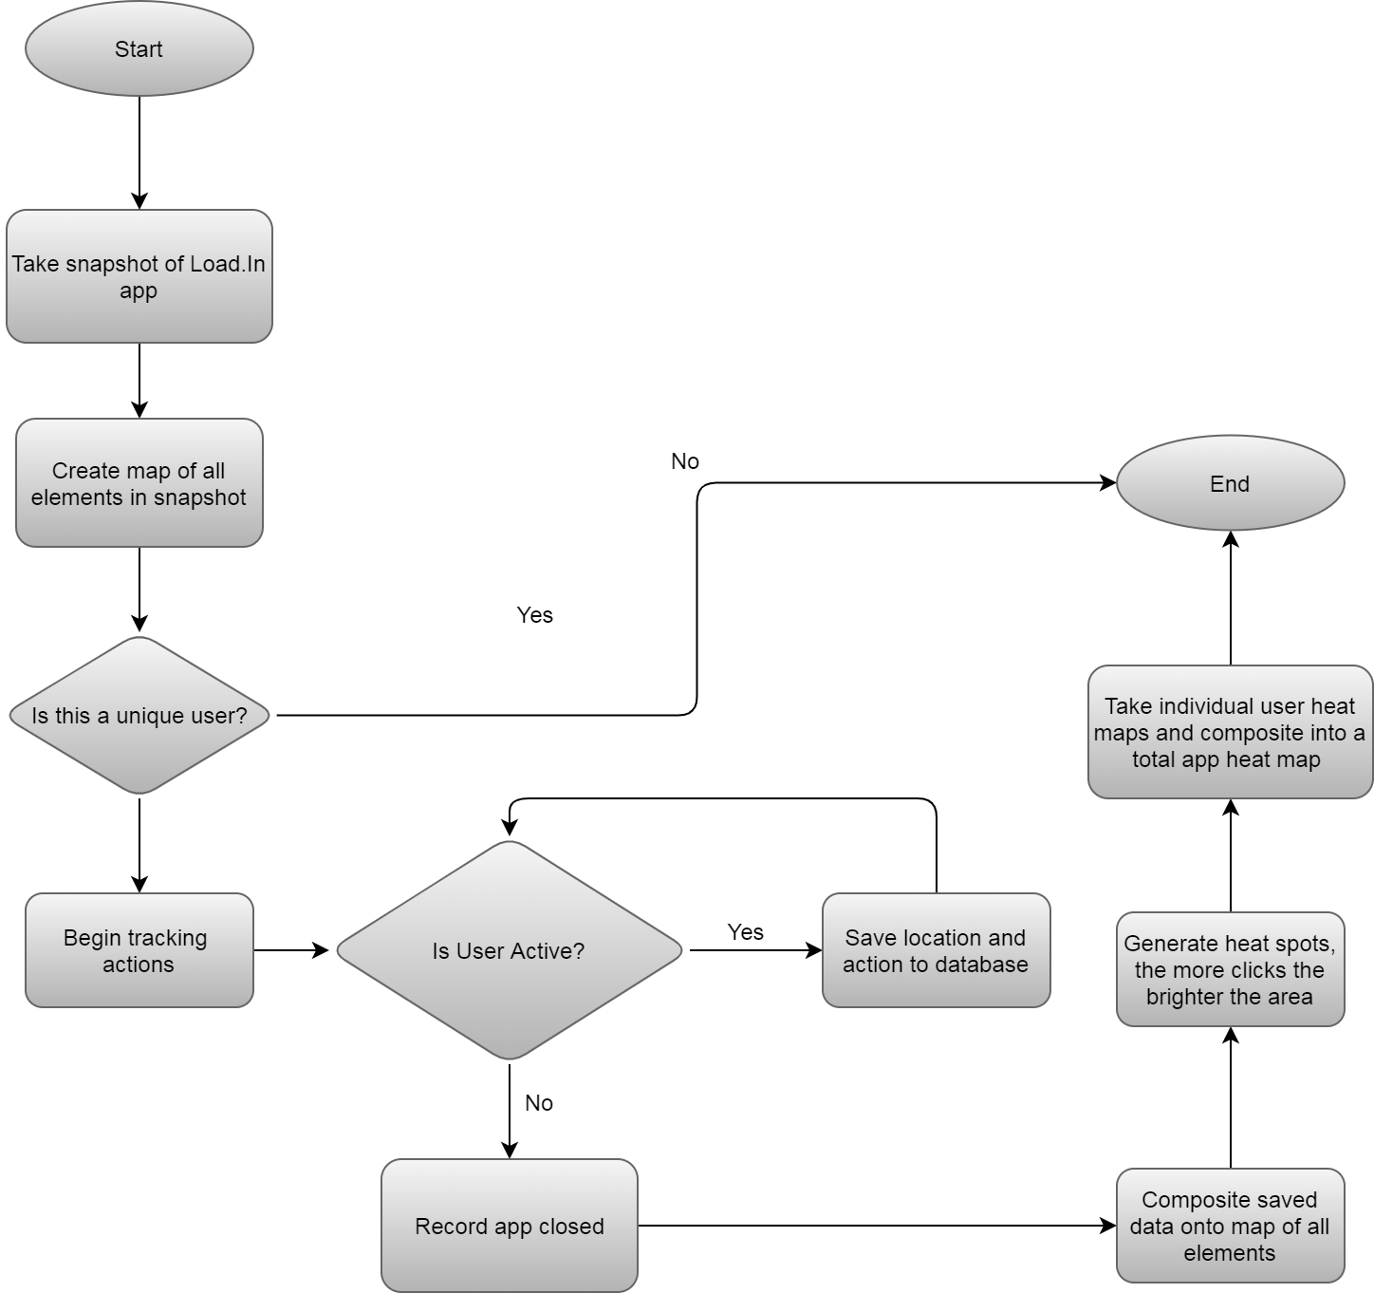
Heat Mapping
CS 410 – Team Yellow – Load.In – Design
38

Slide 39
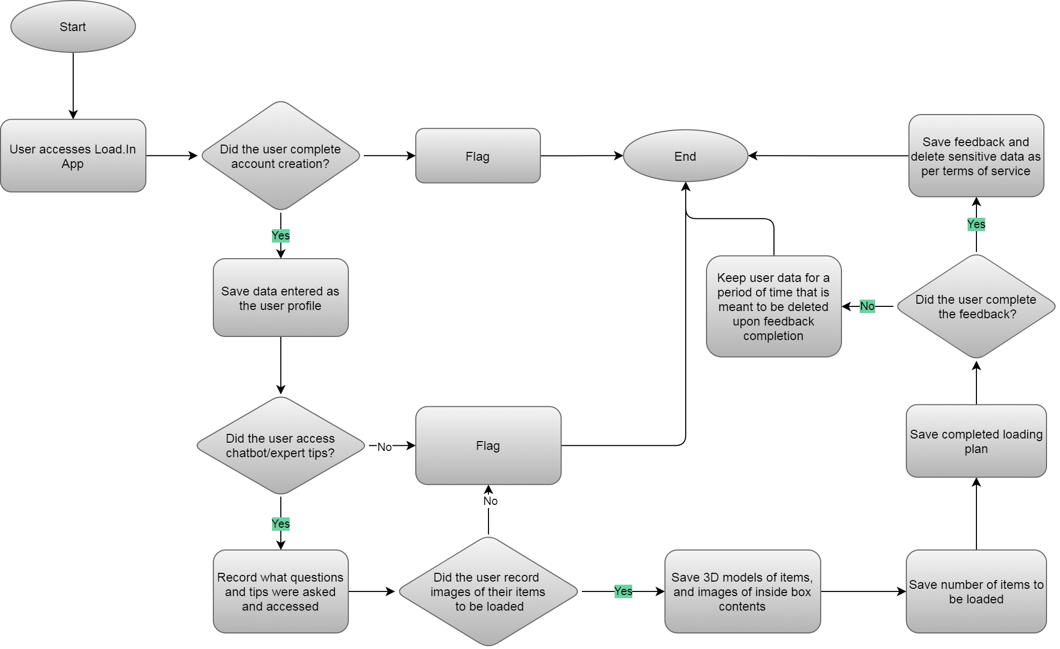
Data Recording Algorithm
CS 410 – Team Yellow – Load.In – Design
39

Slide 40
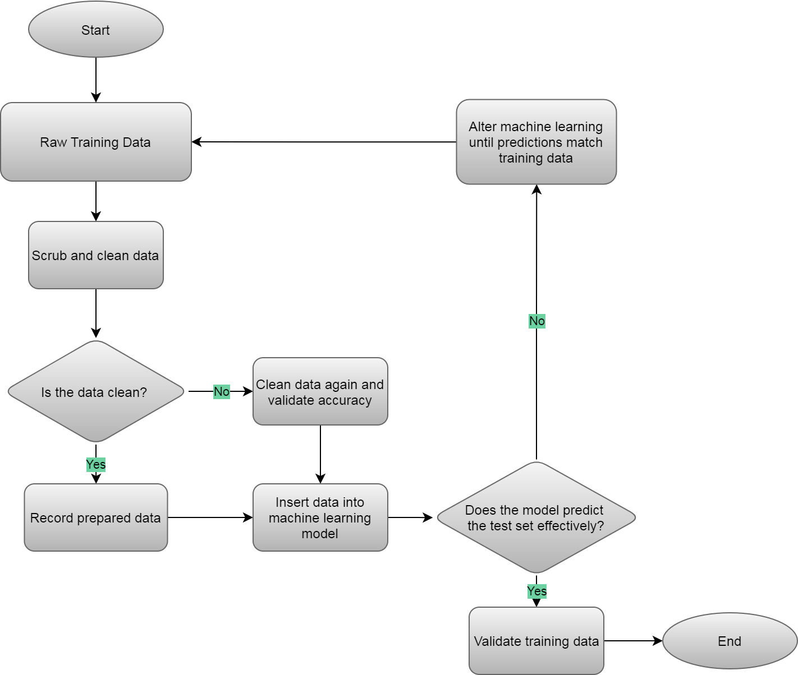
Analytics Training Algorithm
CS 410 – Team Yellow – Load.In – Design
40

Slide 41
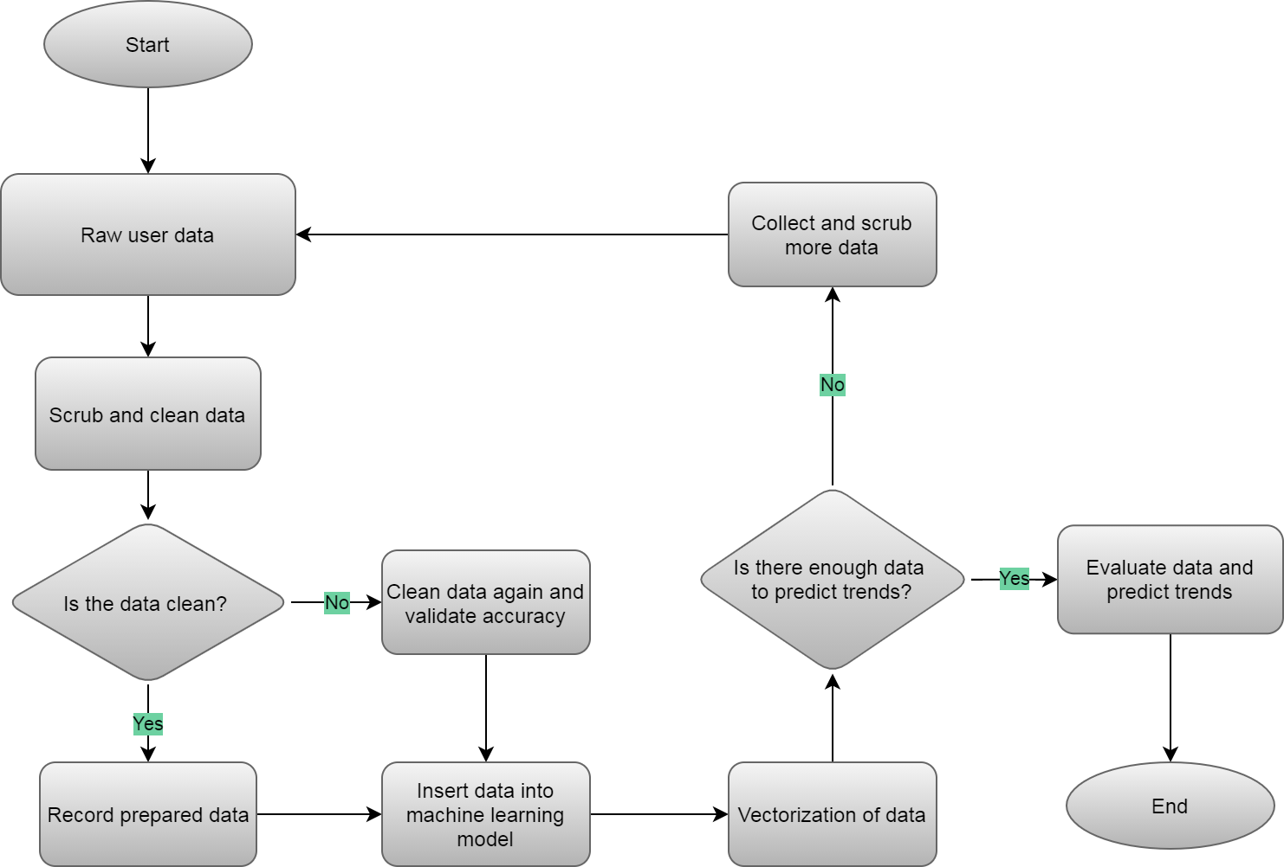
Analytics Prediction Algorithm
CS 410 – Team Yellow – Load.In – Design
41

Slide 42
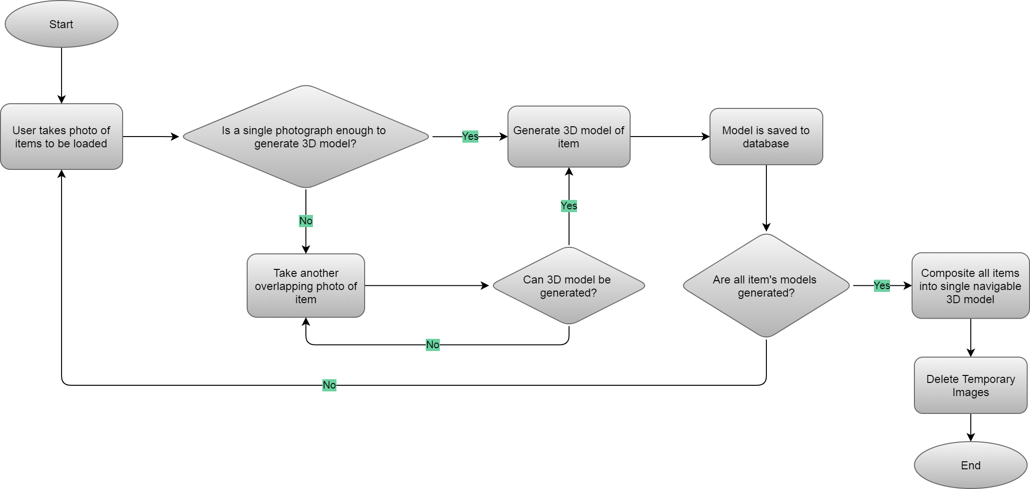
3D Model Generation Algorithm
CS 410 – Team Yellow – Load.In – Design
42

Slide 43
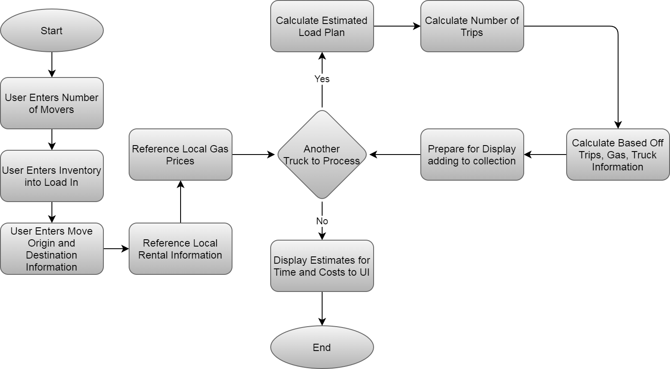
Cost Estimation
CS 410 – Team Yellow – Load.In – Design
43

Slide 44
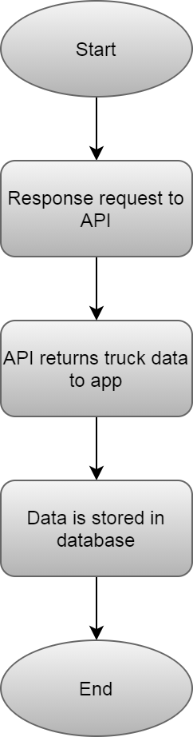
3rd Party Vendor API
CS 410 – Team Yellow – Load.In – Design
44

Slide 45
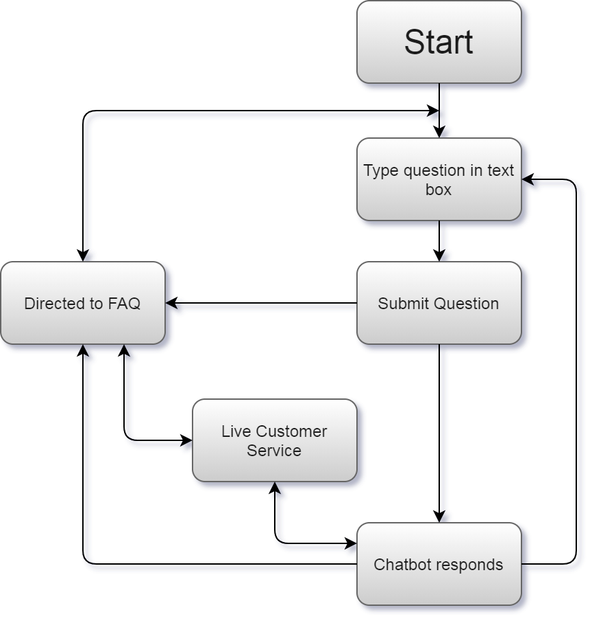
Chat Bot Algorithm
CS 410 – Team Yellow – Load.In – Design
45

Slide 46
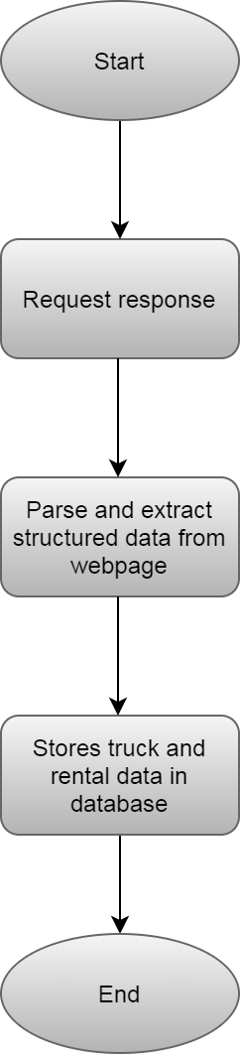
Web Scraper
CS 410 – Team Yellow – Load.In – Design
46

Slide 47
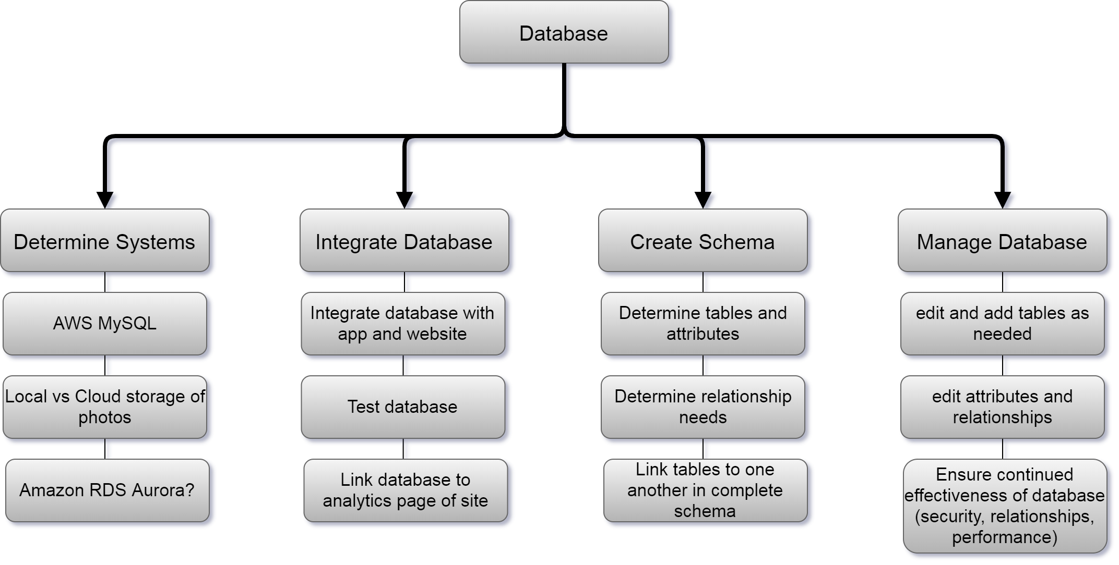
Database
12/3/2020
CS 410 – Team Yellow – Load.In – Design
47

Slide 48
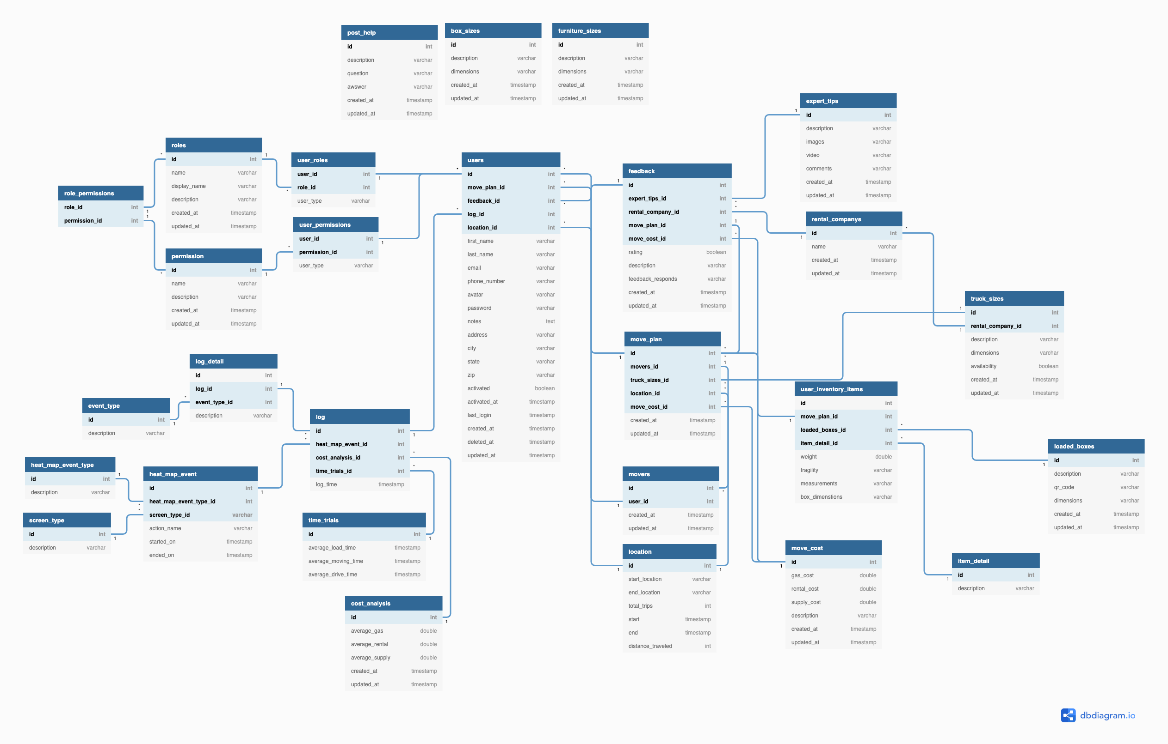
Database Schema
CS 410 – Team Yellow – Load.In – Design
48

Slide 49
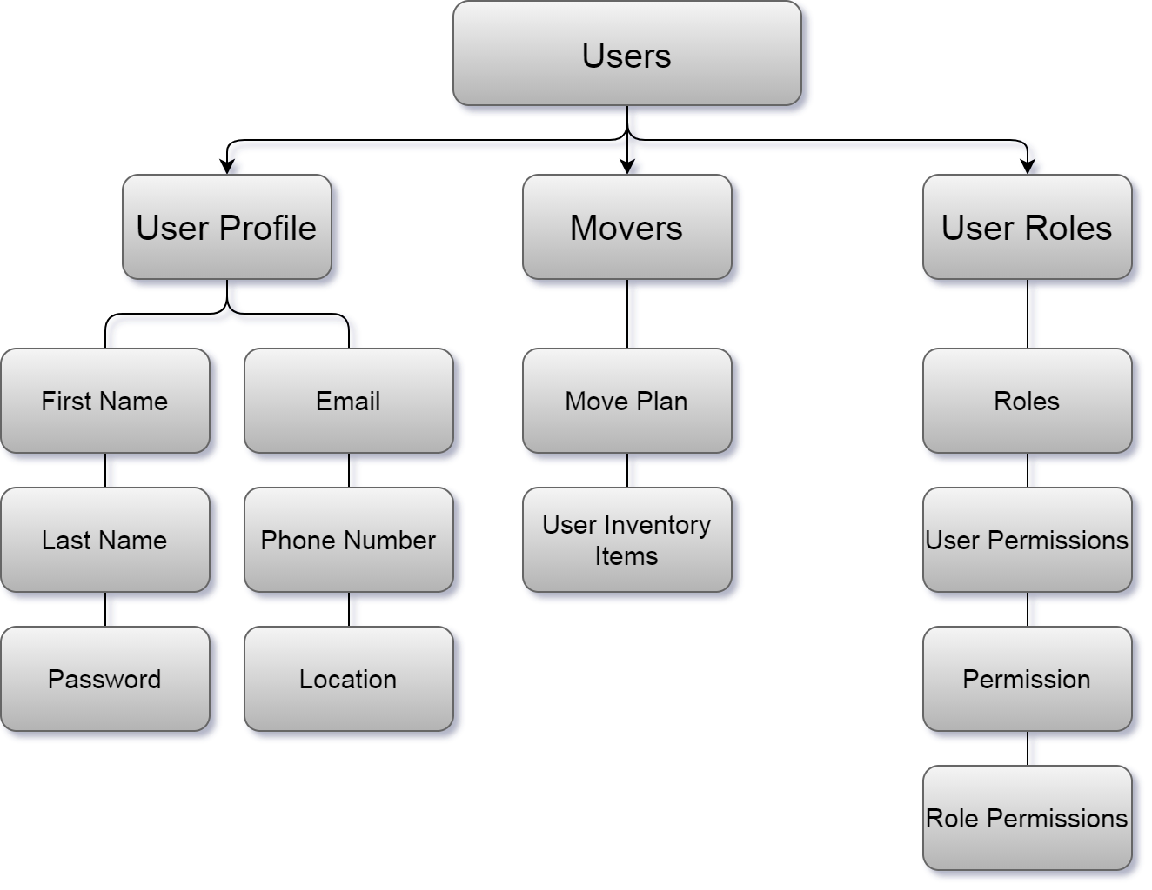
Database Schema
CS 410 – Team Yellow – Load.In – Design
49

Slide 50
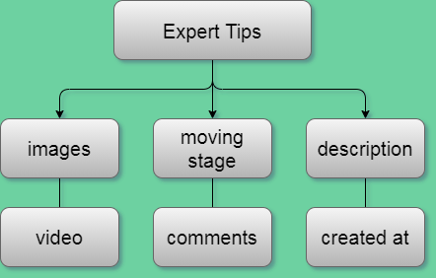
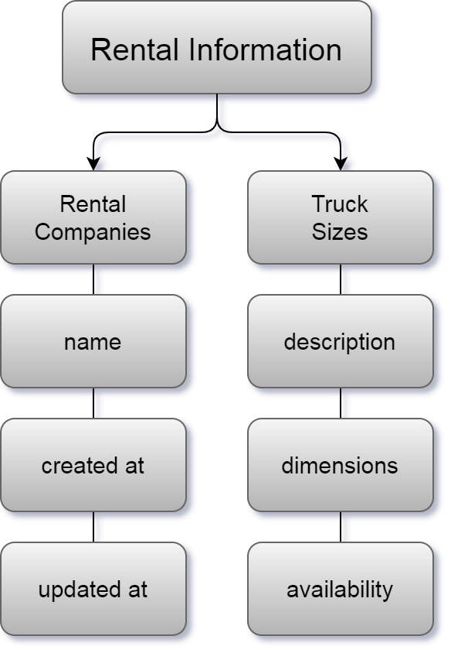
Database Schema
CS 410 – Team Yellow – Load.In – Design
50

Slide 51
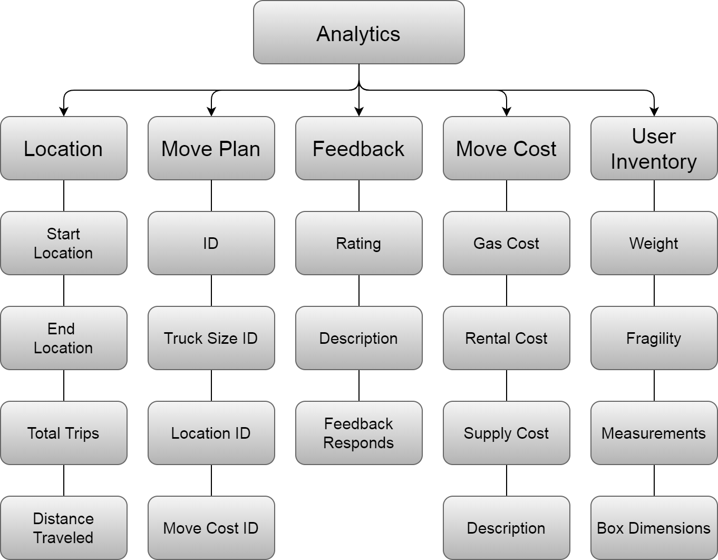
Database Schema
CS 410 – Team Yellow – Load.In – Design
51

Slide 52
Data Management
Data Sources
User
3rd Party Vendor Sites
Load.In System
Data Collected
User Information
Photos
Inventory
Photos for Box Content
Location
Feedback
Truck Rental Information
Expert Tips
Where Persisted?
Amazon RDS
Amazon EFS
User Device
CS 410 – Team Yellow – Load.In – Design
52

Slide 53
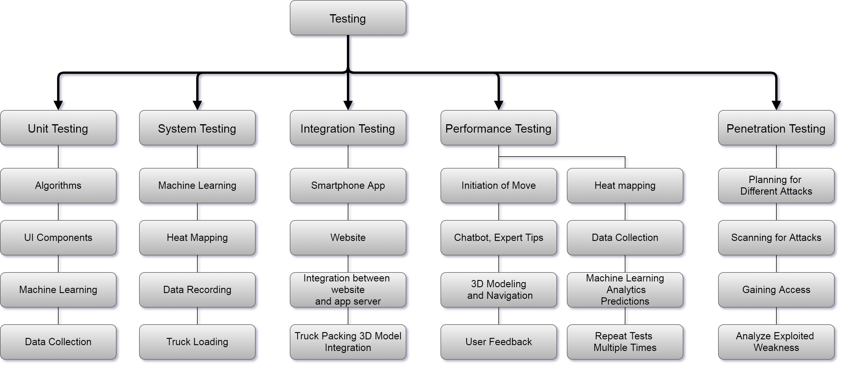
Testing
12/3/2020
CS 410 – Team Yellow – Load.In – Design
53

Slide 54
Sprint Breakdown
Sprint 1
Sprint 2
Sprint 3
Theme: Set up
AI Feedback Loop
User Analytics
Deployment Infrastructure
Framework for other Major Components
Theme: Load In
Photogrammetry
Load Plan Generation
Support Weight, Fragility
Theme: Logistics
Truck Map
Support Unloading Priority
Box Locator
CS 410 – Team Yellow – Load.In – Design
54

Slide 55
Sprint Breakdown
Sprint 4
Sprint 5
Sprint 6
Theme: Packing
Chat Bot
Tips and Tricks
User Photos of Box Contents
Theme: Rentals
Connect to Rental APIs
Cost Estimate/Deal Finder
Theme: Teamwork
Shared Projects
CS 410 – Team Yellow – Load.In – Design
55

Slide 56
Hardware Requirements
Smartphone Client
Computer Client
Specification | Estimated Targeted Value
Operating System | Android 4.4 (KitKat)
RAM | 4GB RAM
CPU | 8 Core @ 1.8Ghz per core
Storage | At least 2 GB internal storage for cache for images and rendered model data 1GB reserved cache for 3D Models Target is 100 cached photos 100 * 55.84 Mb per photo = 5,584 Mb ~ 698 MB
Cellular Connectivity | 4G Cellular up to 15 Mbps
Wireless | 2.4 GHZ @ Wireless N with min 150 Mbps
Internet Connectivity | 30 Mbps
Camera | Single camera lens @ 12 Megapixel
Photo Size | 4290x2800 (~12MP) PNG Compression Approx. 6.98 MB per photo or 55.84 Mb per photo
Photo Transmission Time | < 3 Second @ 30 Mbps Internet Speed < 6 Seconds @ 15 Mbps Cellular
Specification | Estimated Targeted Value
Operating System | Linux, Windows, Mac OS Any operating system that supports current browsers
Browser | Edge, Chrome, Firefox, Safari Browsers must support ES6 or above and HTML 5 Firefox 78 and Above Chrome 84 and Above Edge 83 and Above Safari 13.4 and Above
RAM | 4GB RAM
CPU | 2 cores @ 2GHZ
Storage | 1 GB Cache for images and website content
Wireless | 2.4 GHZ @ Wireless N with min 150 Mbps
Internet Connectivity | 30 Mbps
CS 410 – Team Yellow – Load.In – Design
56

Slide 57










Developer Tools
Category | Website | Android App | Android App | Web API | Web API | Vendor Scraper/ API Reader
Version Control
Issue Tracker
CI/CD
Language | HTML JavaScript
Platform | Spring MVC on Amazon Elastic Beanstalk with Tomcat | Android Native App | Android Native App | Apache CFX on Amazon Elastic Beanstalk with Tomcat | Apache CFX on Amazon Elastic Beanstalk with Tomcat
Database | (or Aurora) on AWS RDS
IDEs | IntelliJ |  | Android Studio |  | IntelliJ
Developer OS | Linux
CS 410 – Team Yellow – Load.In – Design
57

Slide 58
3RD Party Tools
Library | Purpose and Description
3Dorfi | 3D model generation from images Useful for making the 3d models Java library? We don’t know enough about this as to whether we can take code from this and use it
Java 3D | Manipulation for 3D objects in java
AliceVision | 3d photogrammetry library that can reconstruct 3d models from images https://github.com/alicevision/AliceVision downside is it is written in C++
OpenCV | Stands for Open Computer Vision May have java support Does 3d model generation and measurement of objects as well as other functions
Sumerian | Amazon solution for 3d modeling in the browser. Might be something to look at for replacement candidate for rendering
Avis Web API | API for pulling data about Avis rentals into Load.IN
Budget Website | Website for a scrapper to pull in rental information
U-Haul Website
Penske Website
CS 410 – Team Yellow – Load.In – Design
58

Slide 59
Technical Risks
Probability
 |  | Very Low | Low | Medium | High | Very High
Severity | Very High |  |  |  |  | T-1
 | High |  |  |  | T-2
 | Medium |  |  | T-3
 | Low
 | Very Low
T-1: Current technology involving computer vision is a challenge.
T-1 Mitigation: Conduct a prototype to mitigate risk of critical errors upon release.
T-2: Artificial Intelligence prone to error due to insufficient training data.
T-2 Mitigation: Implementing a feedback loopback in the beta phase with test users.
T-3: Challenge to obtain accurate and timely feedback.
T-3 Mitigation: Implement a feature for users to give feedback if the application operated correctly after completing a move.
12/3/2020
CS 410 – Team Yellow – Load.In – Design
59
Notes:
59

Slide 60
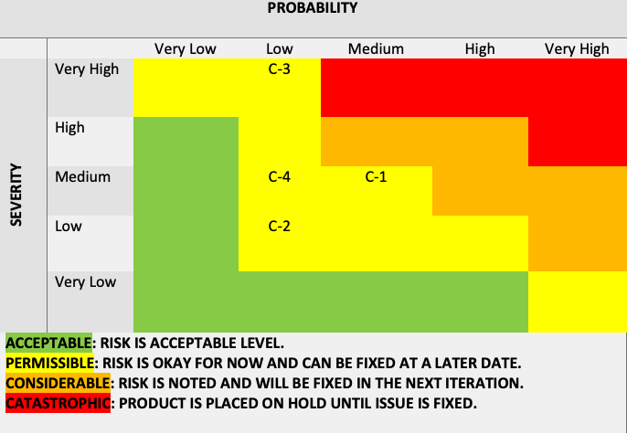
Customer Risks
C-1: End user is inexperienced with the application.
C-1 Mitigation: Implement a tutorial on how to use the application and provide a help feature.
C-2: End user finds UI challenging to operate.
C-2 Mitigation: Implement analytics for tracking when a user stop using the application.
C-3: End users are not satisfied with the recommendations of the application.
C-3 Mitigation: Implement a customer feedback feature that allows the users to disclose his/her issues with the applications.
C-4: End user doesn’t follow the guidelines of the application.
C-4 Mitigation: Implement a feature that allows the user to repeat/reset certain steps in the application as they progress.
Probability
 |  | Very Low | Low | Medium | High | Very High
Severity | Very High
 | High |  | C-1
 | Medium |  | C-2 | C-3
 | Low |  |  |  | C-4
 | Very Low
12/3/2020
CS 410 – Team Yellow – Load.In – Design
60
Notes:
60

Slide 61
Security Risks
Probability
 |  | Very Low | Low | Medium | High | Very High
Severity | Very High
 | High
 | Medium
 | Low |  | S-1,S-2
 | Very Low
S-1: End user want to ensure the pictures taken of personal information doesn’t fall into the wrong hands.
S-1 Mitigation: During the feedback stage after a move, have the end user have the ability to delete personal information collected during the move.
S-2: End user wants to ensure his/her data isn’t being collected for nefarious purposes.
S-2 Mitigation: Allow the end user to opt out of the analytics program inside of the user settings and disclose what his/her data is being used for.
12/3/2020
CS 410 – Team Yellow – Load.In – Design
61
Notes:
61

Slide 62
Conclusion
DIY Movers are faced with many logistical difficulties
Properly loading truck
Protecting valuables
Finding the best deal
Keeping track of every box
All during an already stressful life event!
Load.In will provide customized expert instructions
Truck loading instructions based on photogrammetry
Cost minimization based on input data
Map of truck available to assist in finding boxes
Provide unique insights to moves due to captured analytics
12/3/2020
CS 410 – Team Yellow – Load.In – Design
62
Notes:
62

Slide 63
63
Notes:
63

Slide 64
Sources:
Sources
The Top 5 Moving Mistakes Across America. (2019, August 13). Article. https://www.article.com/blog/top-5-moving-mistakes/
Economy Moving & Storage, LLC. (2015, January 4). How to properly pack and load a moving truck- Movers Cincinnati. YouTube. https://www.youtube.com/watch?v=rjmofUZOdwo&feature=youtu.be
CADCode Systems. (n.d.). Optimizing & Machining | CADCode Systems. CADCode.Com. Retrieved September 20, 2020, from https://www.cadcode.com/category/categories/optimizing-machining
Dube, E. (2020, September 20). OPTIMIZING THREE-DIMENSIONAL BIN PACKING THROUGH SIMULATION. Semantics Scholar. https://www.semanticscholar.org/paper/OPTIMIZING-THREE-DIMENSIONAL-BIN-PACKING-THROUGH-Dube/bb9986af2f26f7726fcef1bc684eac8239c9b853#references
Knoblauch, M. (2019, May 8). One in ten Americans would prefer a week in jail over moving. New York Post. https://nypost.com/2019/05/08/one-in-ten-americans-would-prefer-a-week-in-jail-over-moving/
The American Institute of Stress. (n.d.). The Holmes-Rahe Stress Inventory PDF. Retrieved September 20, 2020, from https://www.stress.org/wp-content/uploads/2019/04/stress-inventory-1.pdf
Wood, T. (2020, January 6). Moving Industry Statistics. MoveBuddha. https://www.movebuddha.com/blog/moving-industry-statistics/
Nat and Friends. (2017, April 18). Google Earth’s Incredible 3D Imagery, Explained. YouTube. https://www.youtube.com/watch?v=suo_aUTUpps&feature=youtu.be
Collins, T. (2018, April 20). A Look Into Photogrammetry and Video Games - Tiger Collins. Medium. https://medium.com/@homicidalnacho/a-look-into-photogrammetry-and-video-games-71d602f51c31
12/3/2020
CS 410 – Team Yellow – Load.In - Design
64
Notes:
64

Slide 65
Glossary:
Glossary
*All definitions are sourced from Wikipedia
Photogrammetry
Photogrammetry is the science and technology of obtaining reliable information about physical objects and the environment through the process of recording, measuring and interpreting photographic images and patterns of electromagnetic radiant imagery and other phenomena.
Algorithm
A finite sequence of well-defined, computer-implementable instructions, typically to solve a class of problems or to perform a computation.
Professional movers
Professionals who move all your belongings for you from one place to another.
Packing problems
Are a class of optimization problems in mathematics that involve attempting to pack objects together into containers. The goal is to either pack a single container as densely as possible or pack all objects using as few containers as possible.
12/3/2020
CS 410 – Team Yellow – Load.In – Design
65
Notes:
65

Slide 66
Appendix - Specifications
Cloud - Blob Storage
Cloud - SQL
Cloud – Web Services/API
Specification | Estimated Targeted Value
Platform | Amazon EFS (Elastic File System)
Storage Requirements | Assuming 500,000 persisted moves at 200 photos for inventory 1 photo = 55.84 Mb 200 photos = 11,168 Mb @ 500,000 Customers 6.226 * 10^5 TB
Iops | Capable of max 100,000 * 55.84 Mb in under 5 seconds (be able to store a photo for 100,000 simultaneous moves in under 5 seconds) Approx. 139.6 GB/s
Specification | Estimated Targeted Value
Platform | Amazon RDS (Relational Database System) Or Aurora?
Vendor | MySQL
Memory | 128GB with scale up capabilities
Storage Requirements | Assuming 20 MB per customer of raw SQL data Approx. 10 TB database Minimum size @ 500,000 customers
CPU | 128 cores @ 4GHZ
Iops | Assuming 100,000 simultaneous users 100,000 * 0.5 MB retrieved data/sec = 50GB read/writes/sec
Specification | Minimum Targeted Value
Platform | Amazon Elastic Beanstalk
Memory | 64GB with scale up capabilities
Storage Requirements | 100 MB < All Target Compiled Files < 500 MB
CPU | 32 cores @ 4GHZ with auto scale up capabilities
Iops | Assuming 100,000 simultaneous users 100,000 * 0.5 MB retrieved data/sec = 50GB capability of data retrieval (depends on the database Iops as well)
CS 410 – Team Yellow – Load.In – Design
66

Slide 67
Appendix - Specifications
Cloud - Web Application
Cloud – Vendor AP Bridge
Specification | Minimum Targeted Value
Platform | Amazon Elastic Beanstalk
Memory | 32GB with scale up capabilities
Storage Requirements | 100 MB < All Target Compiled Files < 500 MB
CPU | 16 cores @ 4GHZ with auto scale up capabilities
Iops | Assuming 20,000 simultaneous users 20,000 * 0.1 MB retrieved data/sec = 2GB /sec capability of data retrieval
Specification | Minimum Targeted Value
Platform | Amazon Lambda
Memory | 16GB with scale up capabilities
Storage Requirements | 10 MB < All Target Compiled Files < 50 MB
CPU | 8 cores @ 4GHZ with auto scale up capabilities
Iops | Assuming 1 GB of data from each rental vendor @ 4 vendors 4GB data in < 30 seconds = 133 MB/s
CS 410 – Team Yellow – Load.In – Design
67

Slide 68
Appendix Data Management
Data Collected | Source | Persisted | When Removed | Storage Location
User Information | User | Yes | -- | DB
Truck Rental Information | 3RD Party Web API 3RD Party Website
Photos for 3D Model Generation | User | Temporarily | After 3D Model Generation Completed | EFS and User Device
Photos for Box Content |  |  | Triggers: After Move Completed and Feedback Submitted Manual Deletion After Period of Time After Move Ended | User Device
Move Inventory |  |  |  | DB
Load Plan | System
User Location Information | User
Anonymous Move Analytics |  | Yes | --
App Usage Information
Feedback
Expert Tips | Move Expert
CS 410 – Team Yellow – Load.In – Design
68

Slide 69
Appendix A1 - User Stories (Mover)
As a mover I need to be able to reset my own password.
As a mover I need to be able to unlock my account via email when I have entered too many incorrect passwords.
As a mover I need to be able to share my move plan with those who are helping me.
As a mover I need to be able create and delete a move plan.
As a mover I need to be able to measure my items.
As a mover I need to be able to reserve and rent a truck.
As a mover I need to be able to see a catalogue of all my items.
As a mover I need to be able to ensure specific items are within reach.
As a mover I would like to have QR codes to help me organize my boxes
As a mover I would like to be able to access a tutorial on how to use Load.In.
As a mover I would like to be able to access a database of commonly found household items.
As a mover I would like to be able to enter a preference on vehicle I would like to rent.
As a mover I would like to be able to access tips if I encounter a problem.
As a mover I would like to be able to rate my experience.
As a mover I would like to be able to provide feedback.
CS 410 – Team Yellow – Load.In – Design
69

Slide 70
Appendix A2 – User Stories (Website Visitor)
As a website visitor I need to be able to see how Load.In works.
As a website visitor I need to be able to see why I should use Load.In.
As a website visitor I need to be able to make a user account.
As a website visitor I need to be able to reset my password.
As a website visitor I need to be able to download Load.In
As a website visitor I would like to be able to see a Frequently Asked Questions (FAQ) about Load.In
As a website visitor I would like to be able to see who created Load.In.
As a website visitor I would like to be able to see the about information for Load.In
As a website visitor I would like to be able to subscribe to a mailing list.
CS 410 – Team Yellow – Load.In – Design
70

Slide 71
Appendix A3 – User Stories (Move Expert)
As a move expert I need to be able to reset my own password.
As a move expert I need to be able to unlock my account through email.
As a move expert I need to be able to create an article about packing.
As a move expert I need to be able to see ratings on my articles.
As a move expert I need to be able to see questions asked by movers.
As a move expert I need to be able to respond to questions asked by movers.
As a move expert I need to be able to provide video instructions of loading.
As a move expert I would like to be able to add images to my articles.
As a move expert I would like to be able to see heat maps provided by application usage.
As a move expert I would like to be able to see which tips are being used the most and least.
As a move expert I would like to be able to search feedback from moves and sort by rating.
As a move expert I would like to be able to respond to feedback.
As a move expert I would like to be able to see the details of load plans I'm helping with.
CS 410 – Team Yellow – Load.In – Design
71

Slide 72
Appendix A4 – User Stories (Rental Company)
As a RAC I need to be able to access anonymous data.
As a RAC I need to be able to see start and end move locations.
As a RAC I need to be able to see when the vehicles are rented compared to moving date.
As a RAC I need to be able to see what percentage of items are fragile.
As a RAC I need to be able to see what type of items are being moved.
As a RAC I need to be able to see the status of rental deals being offered through web API connected to Load.In.
As a RAC I need to be able to provide feedback on my experience.
As a RAC I would like to be able to see feedback on the information quality of the move.
As a RAC I would like to be able to see feedback on potential improvements of rental company.
As a RAC I would like to be able to respond to feedback.
As a RAC I would like to be able to see information regarding my truck dimensions and boxes being used.
CS 410 – Team Yellow – Load.In – Design
72

Slide 73
Appendix A5 – User Stories (Chat Bot Admin)
As a chat bot admin I need to be able to read questions submitted by a user.
As a chat bot admin I need to be able to provide detailed responses to the user.
As a chat bot admin I need to be able provide answers to all questions movers may have.
As a chat bot admin I need to be able to maintain my state as the user scans the FAQ and my output.
As a chat bot admin I would like to be able to provide links to articles to users.
CS 410 – Team Yellow – Load.In – Design
73

Slide 74
Appendix A6 – User Stories (Administrator)
As an administrator I need to be able to see system logs.
As an administrator I need to be able to receive notifications on if thresholds have been met.
As an administrator I need to be able to create and delete user accounts.
As an administrator I need to be able to edit user information and privileges.
As an administrator I need to be able to see any errors the system is producing.
As an administrator I need to be able to back up the entire database.
As an administrator I would like to be able to see heat maps to see any issues.
As an administrator I would like to be able to send push notifications to all users.
As an administrator I would like to be able to query number of users.
As an administrator I would like to be able to query statistics for future improvement.
As an administrator I would like to produce ad hoc reports.
CS 410 – Team Yellow – Load.In – Design
74

Slide 75
Appendix A7 – User Stories (Tester)
As a tester I need to be able to enter fake data to test edge cases.
As a tester I need to be able to see how the application responds if I purposely do not follow my Load plan.
As a tester I need to be able to enter the truck rental system to enter test data.
As a test I need to be able to ask the chat-bot non-typical questions.
As a tester I need to be able to provide feedback to developers.
As a tester I need to be able to tell the programmers they write spaghetti code. >:(
CS 410 – Team Yellow – Load.In – Design
75

Slide 76
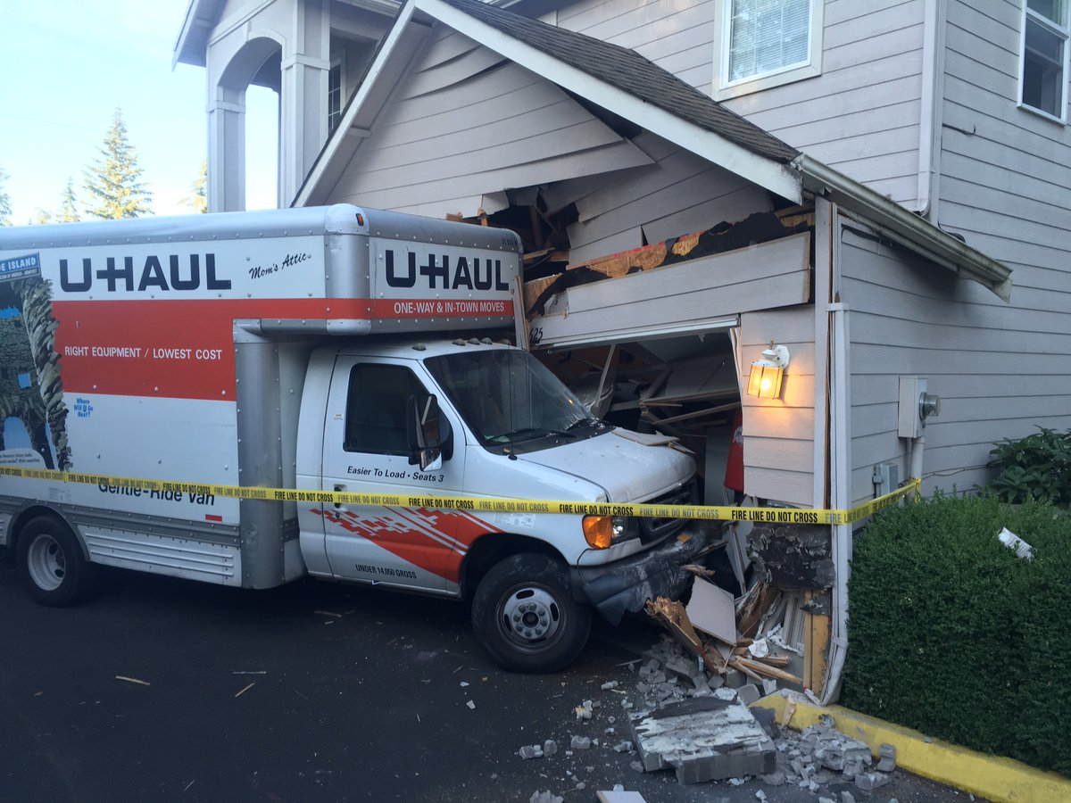
Loading Can Be a Major Issue
Poor loading can cause
Property damage
Car accidents
An estimated 50,000 accidents related to trailer towing occur each year.
This Photo by seattletimes.com is licensed under CC BY
Hayesbc.com
12/3/2020
CS 410 – Team Yellow – Load.In – Design
76
Notes:
76

Slide 77
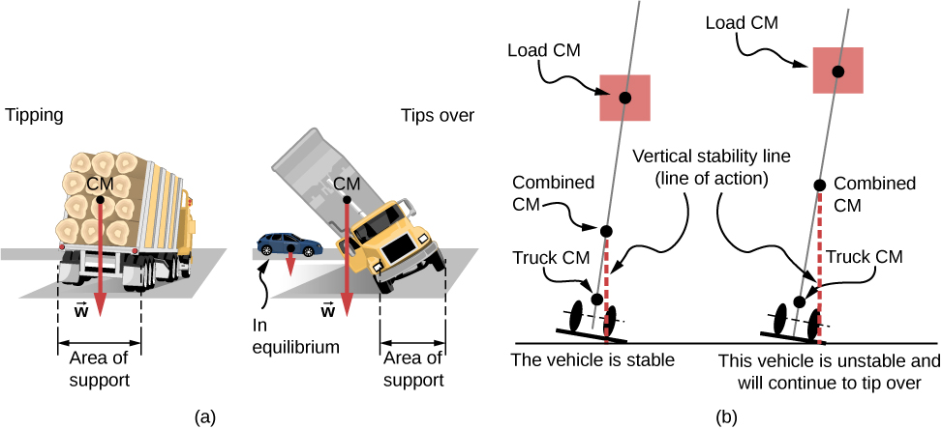

Major Truck Loading Considerations
Weight distribution
Protecting fragile items
This Photo by courses.lumenlearning.com is licensed under CC BY
This Photo by packlane.com is licensed under CC BY
PenskeTruckRental.com
12/3/2020
CS 410 – Team Yellow – Load.In – Design
77
Notes:
77

Slide 78
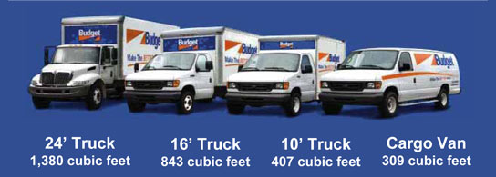
Figuring Out What to Rent is Hard!
Accurately determining
How big of a truck to get
How many trips a move will take …is difficult.
Rental Truck companies base their business model on this!
This Photo by uhaul.com is licensed under CC BY
This Photo by truckbodyeast.com is licensed under CC BY
wtkr.com
12/3/2020
CS 410 – Team Yellow – Load.In – Design
78
Notes:
78

